Slide 1
C-Data CMS Introduction
Shenzhen C-Data Technology Co., Ltd.

Slide 2
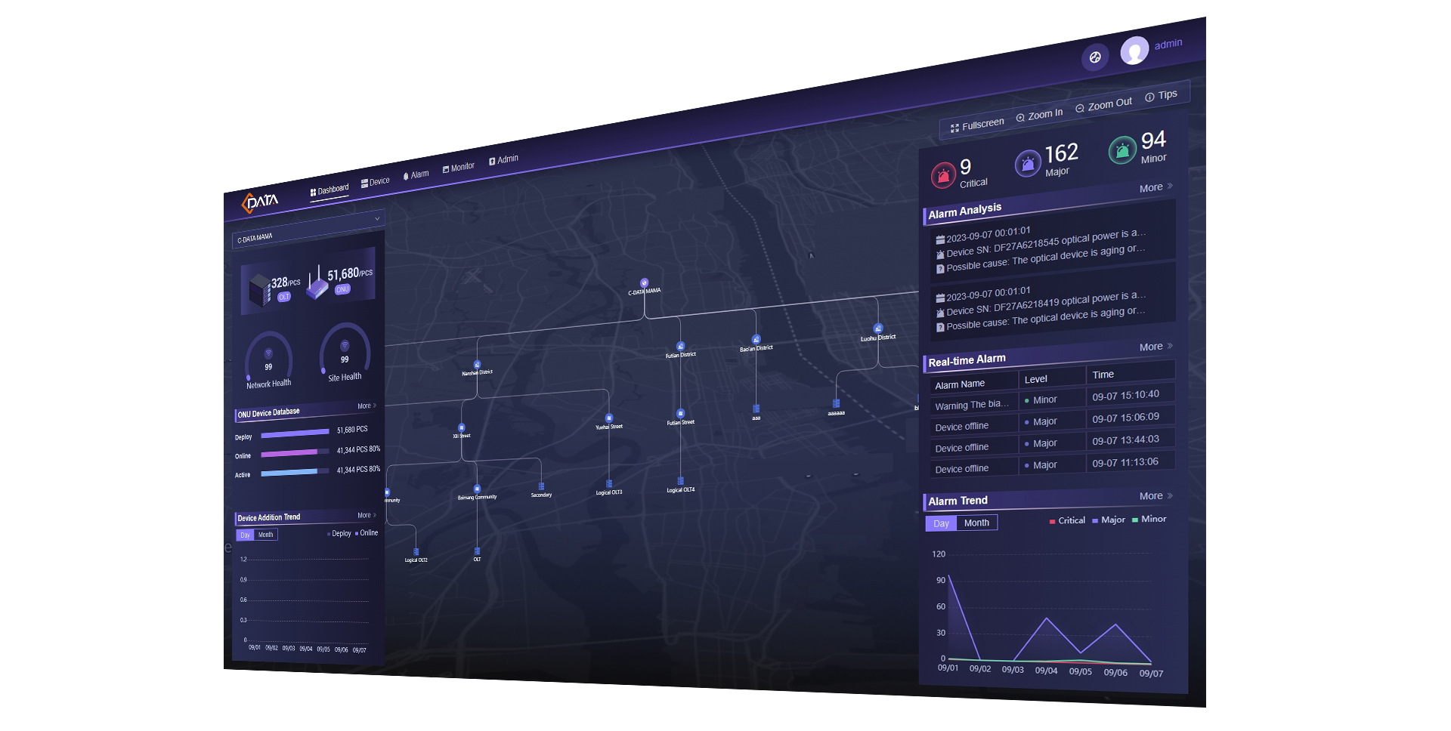
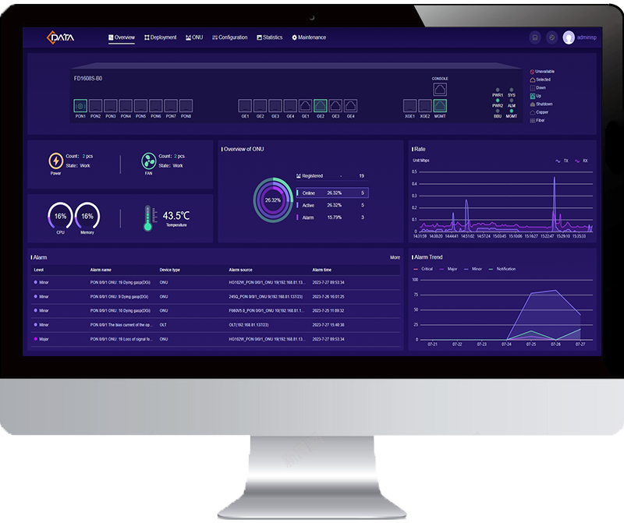
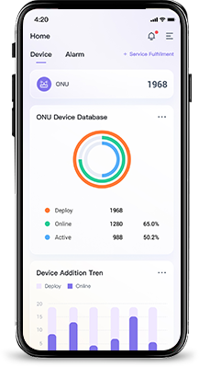
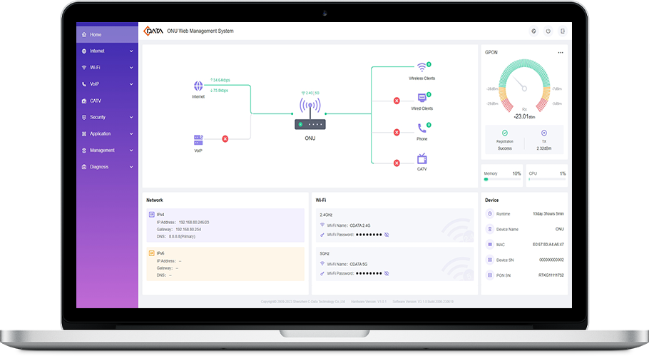
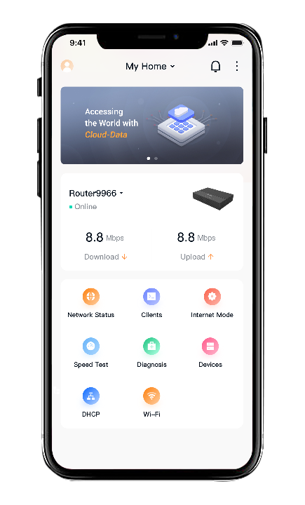
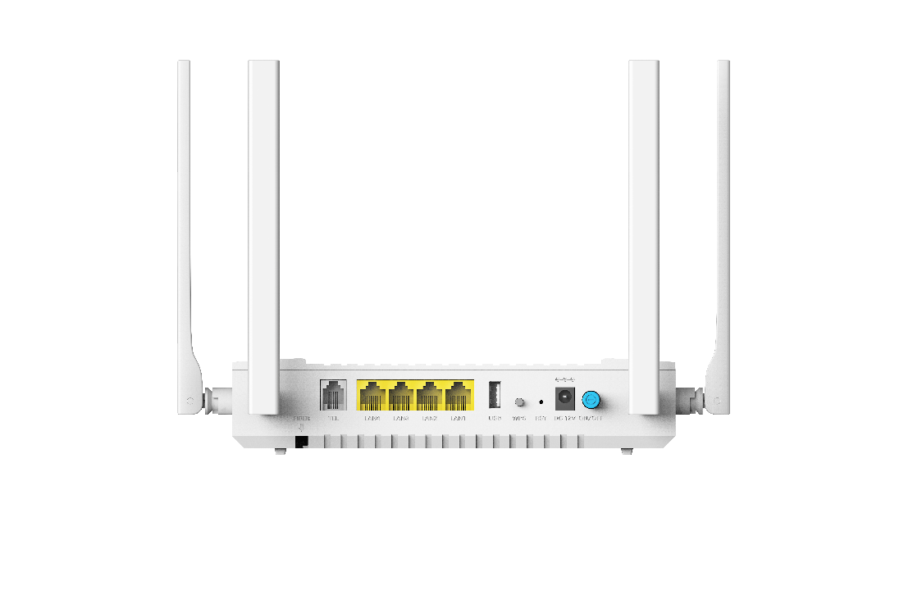
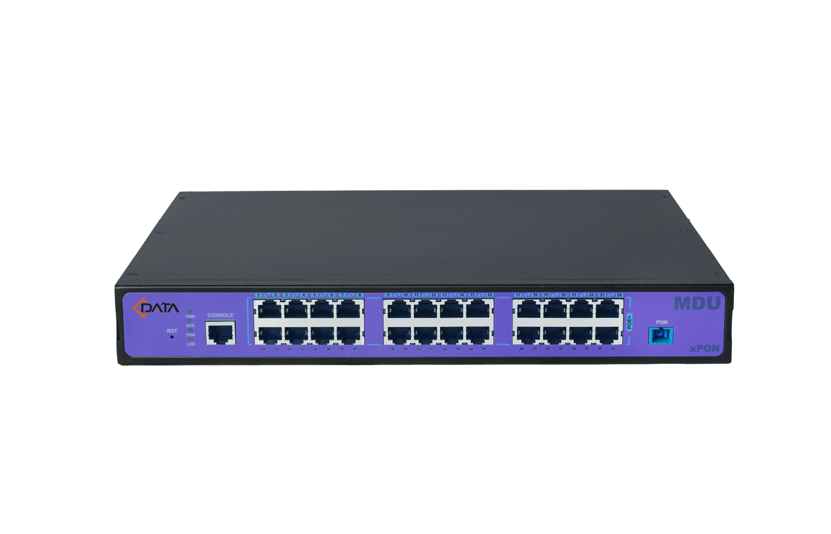
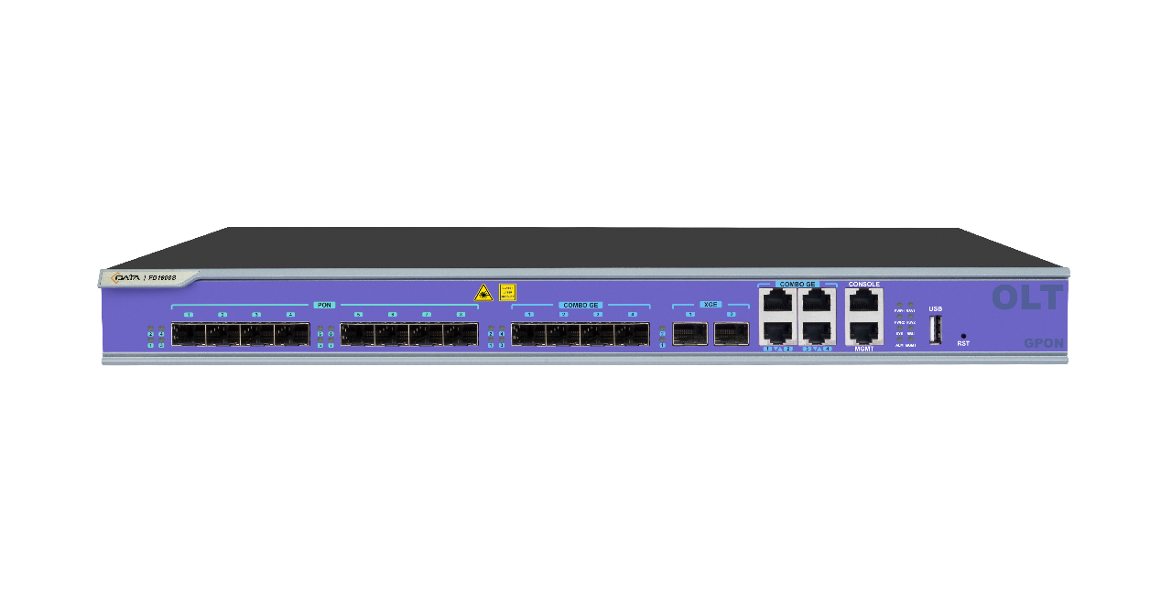
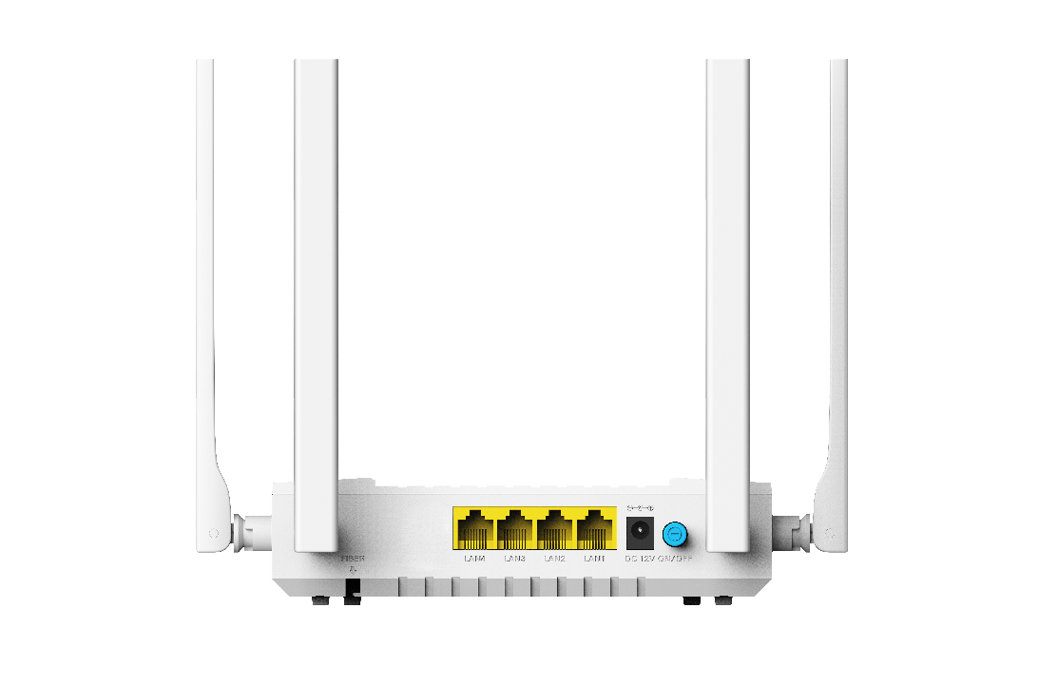
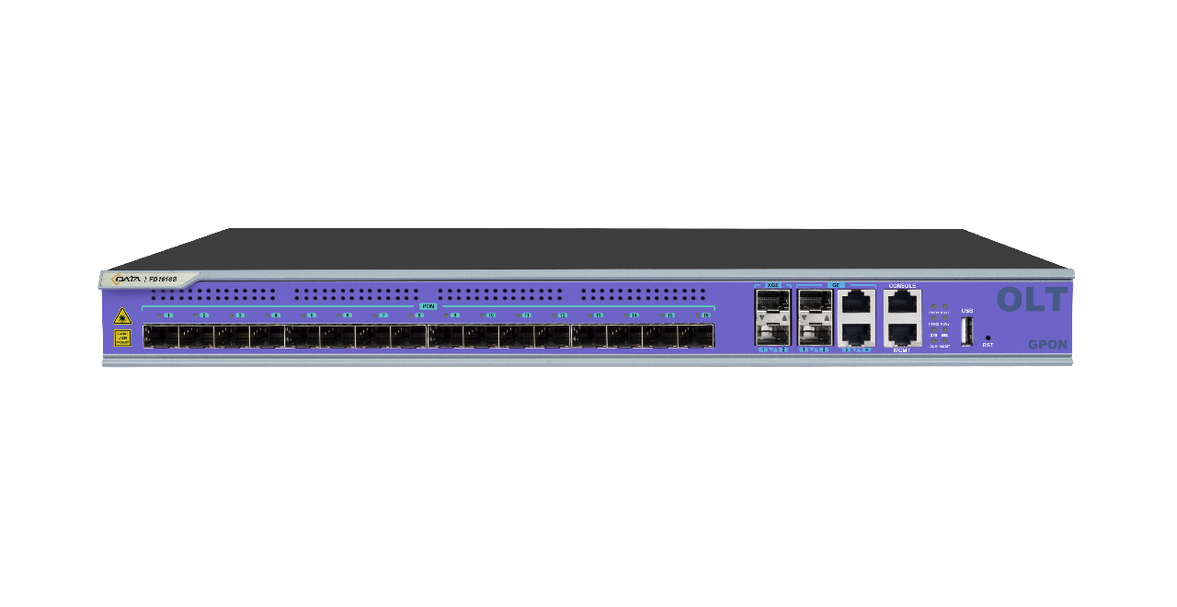
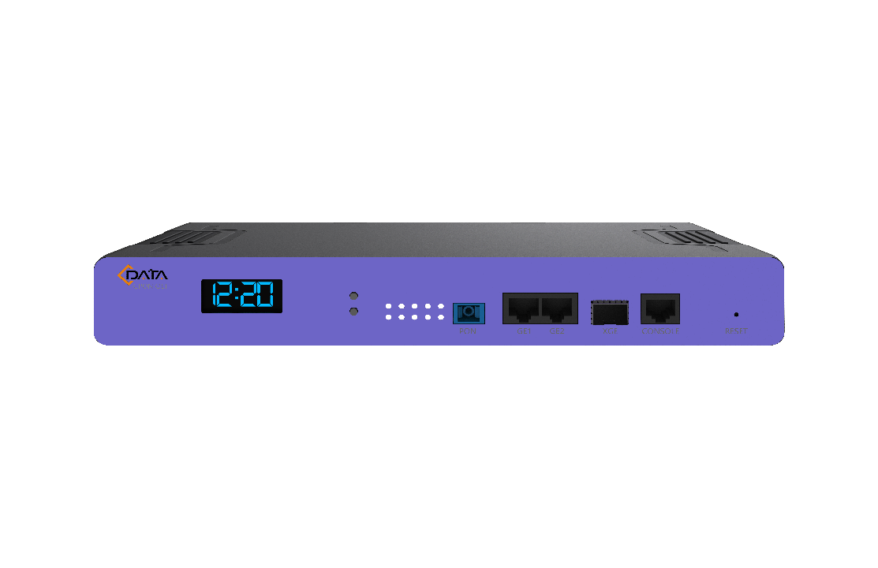
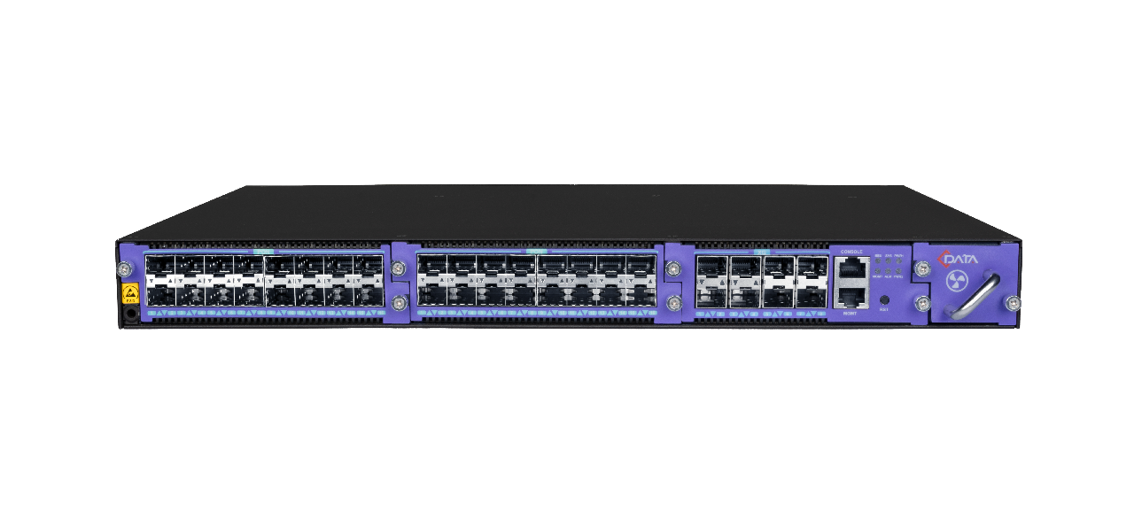
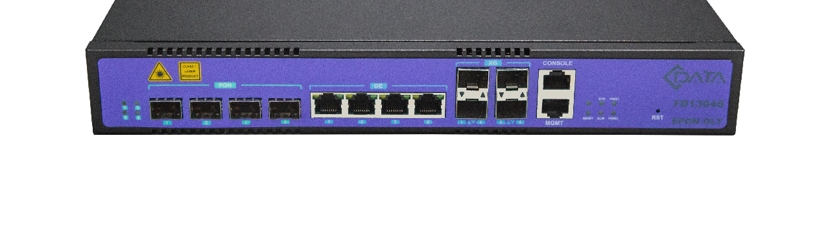
CMS: An Integrated Management System
Comprehensive Device Management
Inclusive support for OLT, ONU, routers, and third-party devices.
Flexible Deployment Options
Flexible deployment options - SaaS, On-Premise, and Northbound interfaces.
Optimal Solution through Software-Hardware Synergy
Achieves the best solutions by harmonizing software and hardware.
Intuitive Network Control
Streamlined network monitoring and control from anywhere via a
user-friendly web interface and mobile app.
Notes:
1. Comprehensive Device Management
解说：设备管理，OLT,ONU，路由器等，特别是第三方设备
Explanation: CMS excels in managing a wide range of devices, covering key components like OLT and ONU, and goes the extra mile by seamlessly integrating with third-party devices.
2. Flexible Deployment Options:
解说：部署方式灵活，SaaS/私有，APP， 将我们，分销商，运营商，终端用户形成了闭环
Explanation: CMS offers adaptability in deployment methods, catering to user preferences with options like Software as a Service (SaaS), private deployment, and accessible APP services. This creates a closed-loop ecosystem connecting our company, distributors, operators, and end-users.
3. Optimal Solution through Software-Hardware Synergy
软硬件配合提供最佳解决方案，相对单纯软件或硬件很难做到
Explanation: Unlike standalone software or hardware solutions, CMS ensures optimal performance and addresses complex needs by seamlessly integrating software and hardware components. This synergy results in a more comprehensive and effective solution.

Slide 3
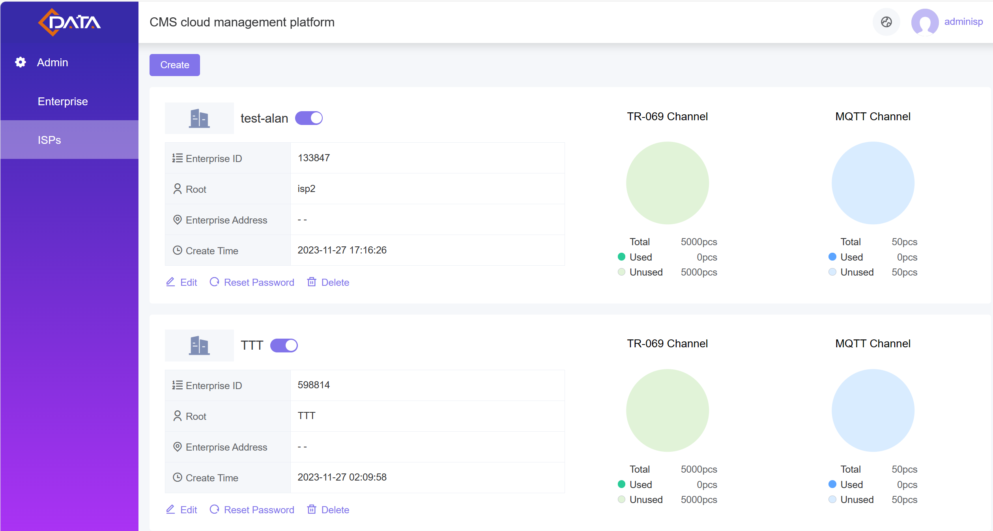
What Benefits Does CMS Offer for Distributors
and Operators Respectively?
Distributors can allocate CMS accounts and resources to ISPs.
Offering unified deployment of sold ONUs
Improved Coordination, aligning efforts with ISP capabilities and resources.
Better Insight, a comprehensive view of the network and customer activities, plan purchases based on usage and offer equipment recommendations.
ISP Info
Usage
How CMS benefits ISPs?
Use analytics to develop new services and optimize existing service plans.
Benchmark performance against industry standards and competitors.
CMS provide automatic warnings based on customer behavior to assist ISPs in retaining customers.

Slide 4
Compare to third-party ACS platforms, what are the advantages of CMS?
 | CMS | Other ACS platforms
Device Support | TR-069 ONU, including third-party ONUs OLT and subordinate ONUs, including third-party OLTs (coming soon) Routers, switches, etc. | Only support TR-069 ONUs.
Configuration Operations | Towards WAN/LAN/Wi-Fi/VoIP/CATV business scenarios, providing visual operations. | Towards data models, requiring high professional expertise.
Software-Hardware Integration | Integrates with the hardware platform, supporting the most features and maximizing performance. | Only achieve functionality based on the TR-069 standard protocol.
Deployment Options | SaaS On-Premise Northbound interfaces. | Only support 1-2 deployment options.

Slide 5
I already have a system, is it necessary to use CMS?
Northbound Interface
OSS/BSS
Service
Layer
1
CMS offers a coexistence mode.
It provides a northbound interface, allowing your existing software to connect with CMS, reducing the standardization challenges of direct device integration.
CRM
Billing
Monitoring
2
Protocol
Layer
Alternatively, CMS can replace or complement your existing software.
Especially in managing third-party devices (ONU, OLT), offering a centralized solution for efficient management.
......
Network Device

Slide 6
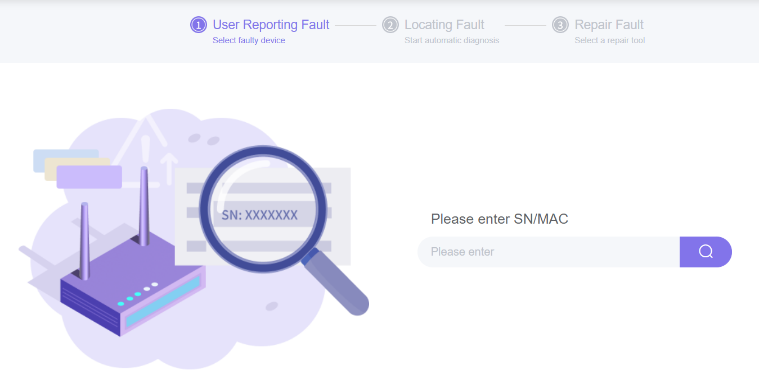
CMS: One Stop Network Device Management Center
The CMS platform goes beyond simply integrating EMS and ACS tools;
It offers a wealth of additional features designed to empower operations, accelerating your work and enhancing overall efficiency.
These value-added features contribute significantly to streamlining tasks and maximizing operational value.
Effortlessly Manages 500,000 Devices
Real-time Monitoring and Alarm
Dashboard and Topology Visualization
Simplified Configuration Operations
Automated Troubleshooting

Slide 7
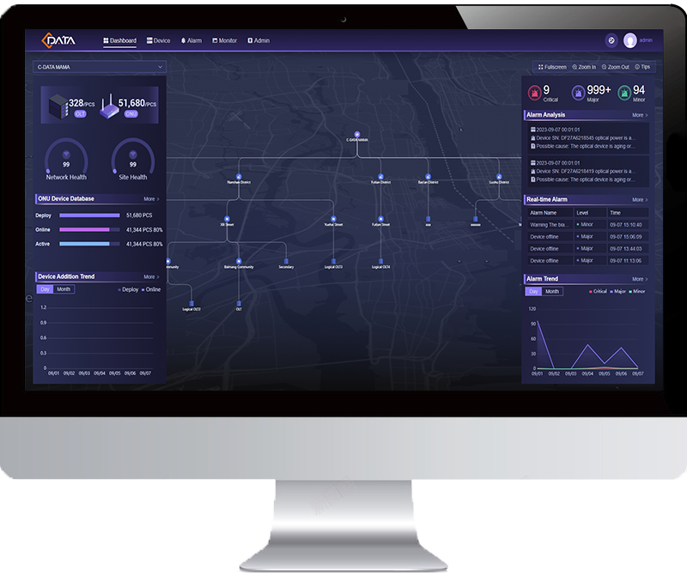
Advantage 1: Integrated EMS and TR069 ACS
Operators usually use separate software to control OLT devices (EMS) and terminal devices like HGU (ACS) using the TR069 protocol.
Now, with CMS, these tasks are combined. It's like having a single remote control for the whole network.
TR069
MQTT
OMCI / OAM
C-Data OLT
IP
C-Data CMS
Third-party OLT
EMS
TR-069 ACS
TR069
All-in-One Management
You can now manage both OLTs and ONUs using one platform and one easy interface. No more switching between different tools!
Excellent Compatibility
Directly handle TR-069 compatible ONUs, ensuring seamless integration with third-party devices. Manage OLTs and subordinate ONUs on a unified platform. Upcoming support for Third-party OLTs, enhancing flexibility in your network management.

Slide 8
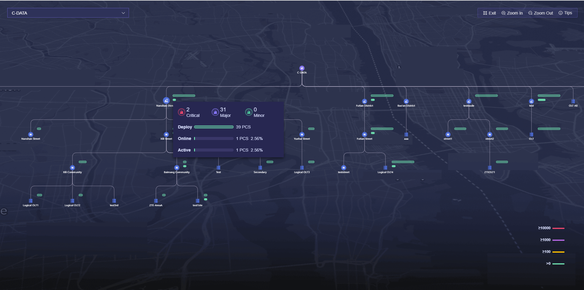
Advantage 2: See Your Network Come to Life
Visualize OLT and ONU distribution, track real-time network health, and monitor individual OLT performance and its associated ONUs for effective network management.
Monitor the real-time performance of each OLT and its associated ONUs.
Gain a complete understanding of your network's heartbeat within a specific region.
Gain insight into the overall online status of OLT and ONU, network health, and site health.
The distribution quantity of OLT and ONU, distinguishing with different colors.

Slide 9
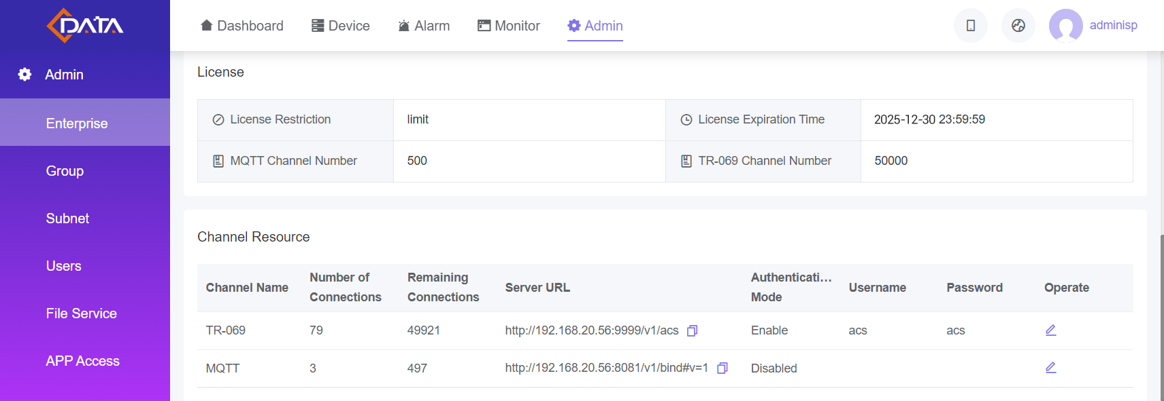
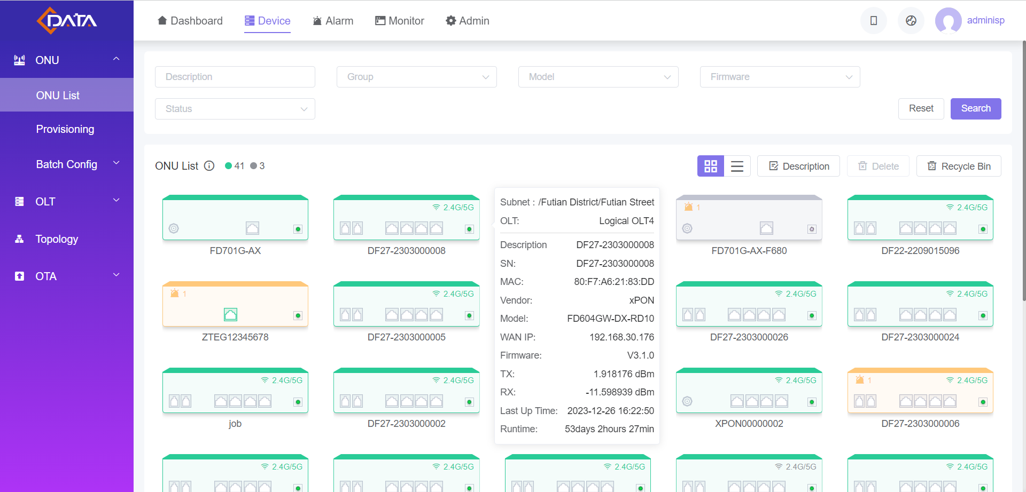
Advantage 3: Scale Seamlessly with C-Data CMS
Effortlessly Manages 500,000 Devices
Unlock the potential of your network with CMS’s effortless scalability, ensuring smooth operation and growth.
Support filtering ONUs by model, firmware, status and other attributes.
Licenses can be allocated based on business and network requirements.
Different colors indicate the status of devices, facilitating quick identification for management:
Green: Online - Normal
Orange: Online - Abnormal
Gray: Offline

Slide 10
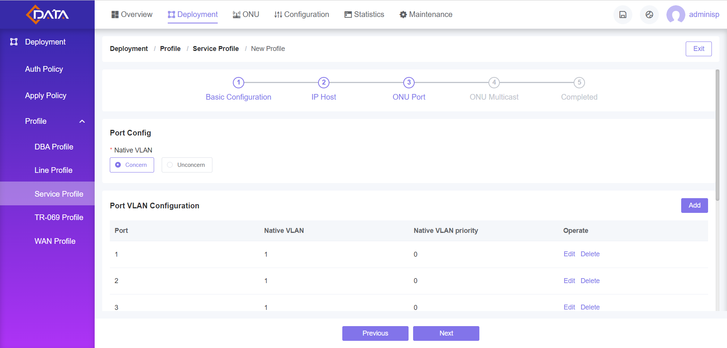
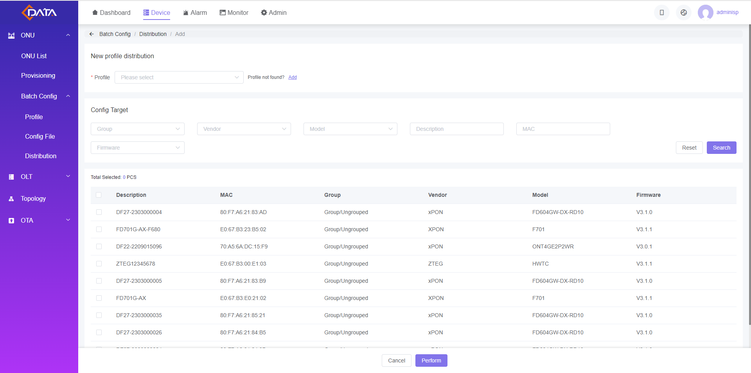
Advantage 4: Simplified Configuration and Setup
Say goodbye to complexities. CMS’s plug-and-play simplicity streamlines the process, letting your network grow effortlessly.
Guided steps for easy deployment, set up step by step to complete.
Support filtering ONUs by vendor, model, MAC, firmware, and other attributes.
Execute batch configuration operations for ONUs, simplifying setup and maintenance tasks.

Slide 11
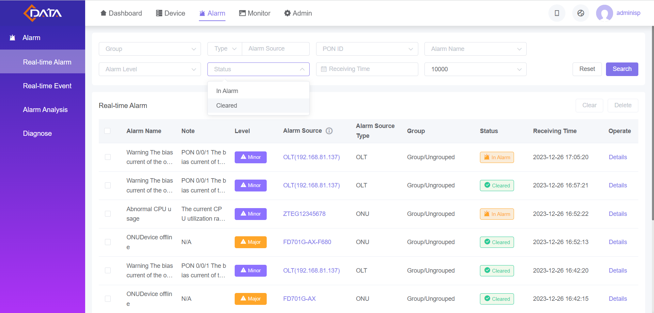
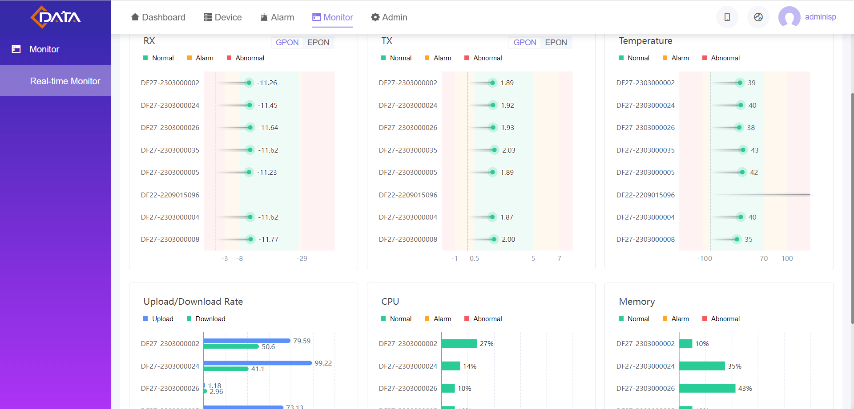
Advantage 5: Real-time Monitoring and Alarm
Be Proactive with CMS, harness the power of real-time data. Address network issues swiftly for an enhanced user experience.
Represent alarm levels and status with different colors.
Utilizing alarm data to differentiate between individual and regional issues, whether it's a backbone fiber link anomaly or instability in a specific area's power supply.
Providing a proactive warning mechanism for potential business risks associated with regional devices.
The home page displays the total number of alarms, analysis, real-time alarms, and alarm trends for all devices.
Customizable monitoring triggers to set specific alarm conditions, enhancing proactive issue identification.

Slide 12
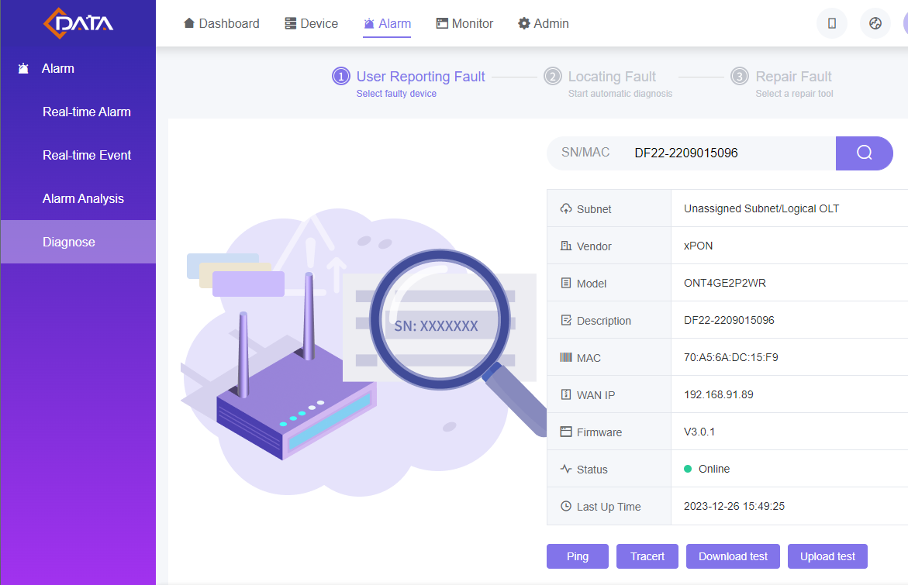
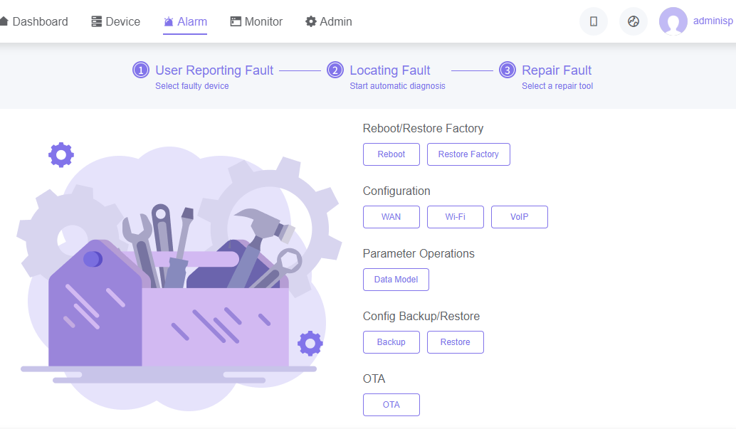
Advantage 6: Automated Troubleshooting
Automatic inspection and troubleshooting of issues, reducing downtime and improving network reliability.
1
Display basic information of devices with alarms for verification.
2
Comprehensive diagnostics
3
Automatic execution of various common fault repair tools

Slide 13
Advantage 7: Intelligent Business Analysis
Smart Data Dashboard
Statistical analysis of specific region user trends, aiding clients in adjusting investments based on user growth or reduction.
Analyzing upstream service flows to prompt timely bandwidth upgrades, meeting users' evolving traffic demands.
Smart Data Analysis
Recognizing user churn risks based on network usage, offering timely alerts for clients to focus on end-users.
Smartly notifying clients about impending expiration of user packages, facilitating targeted marketing activities for soon-to-expire users.

Slide 14
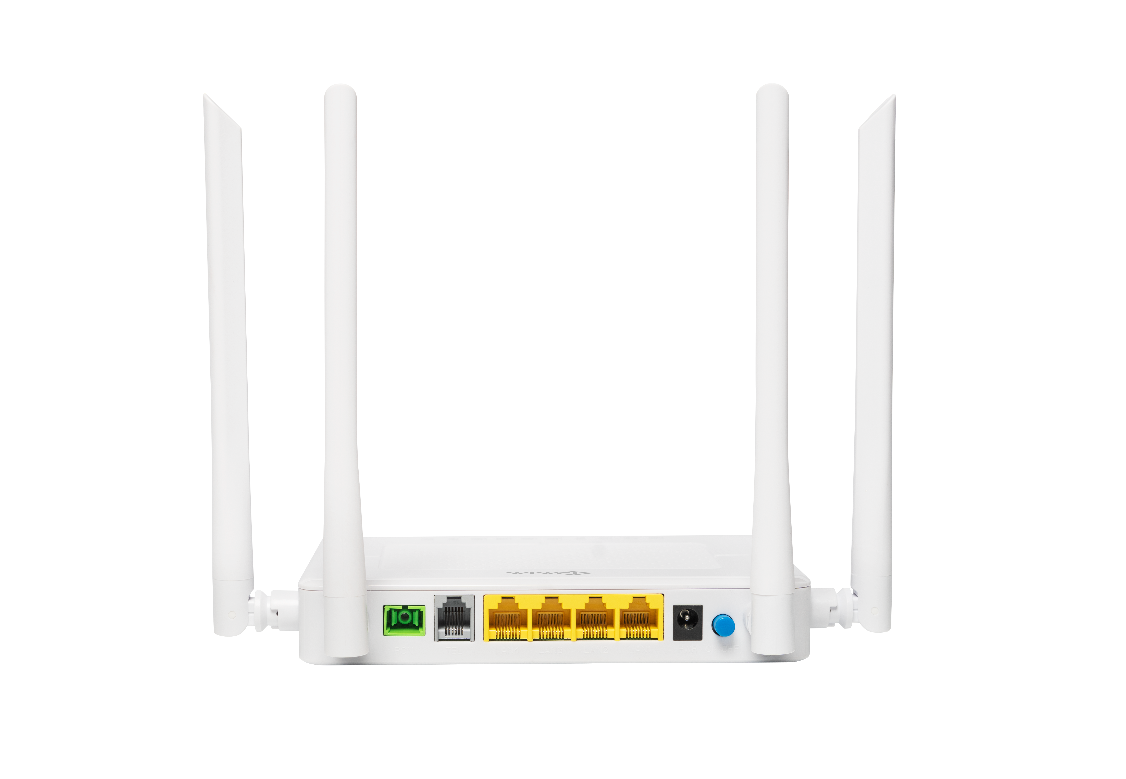
Advantage 8: Flexible Deployment Options
Choose between on-premise and SaaS deployment, providing flexibility for different operational preferences.
Single ISP
Distributors
Apply for On-Premise or SaaS deployment
Bind ONU/OLT devices
Apply for On-Premise or SaaS deployment
Create multiple ISPs
Each ISP independently binds ONU/OLT devices
ISP
Reseller
1
Deploy
2
Create ISP A
Deploy
2
Create ISP B
1
On-Premise / SaaS
CMS Server
On-Premise / SaaS
CMS Server
2
Bind
ISP A
3
Bind
ISP B

Slide 15
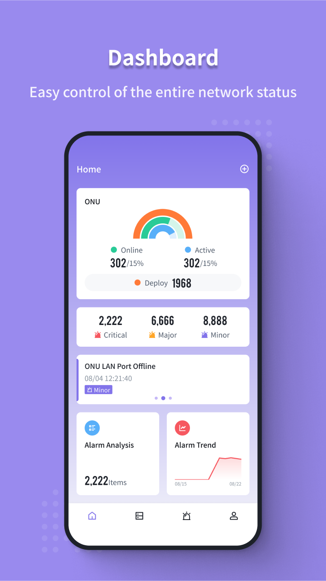
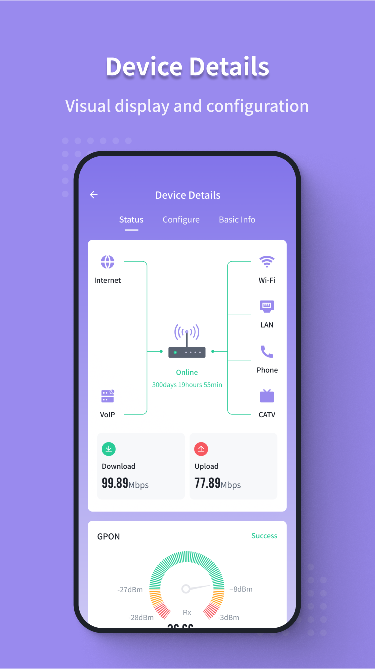
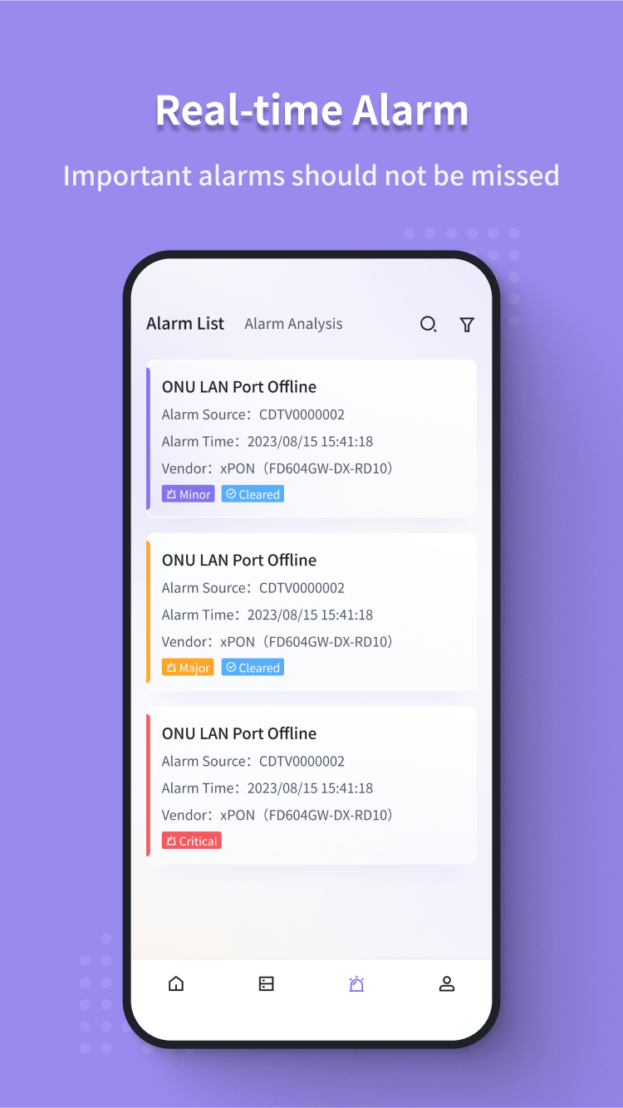
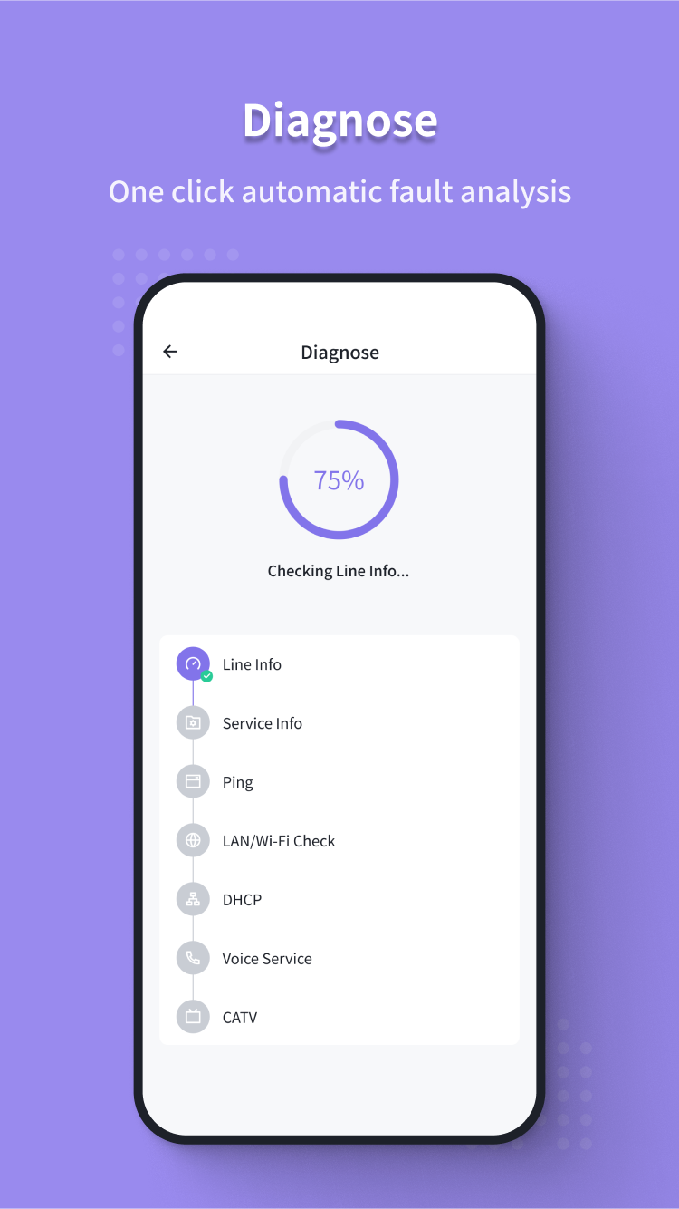
CMS APP: Anytime! Anywhere!
Offering seamless management capabilities for checking network health and resolving issues instantly, as well as facilitating on-site operations.
Effortless Network Control
Use the app to check network status, view real-time alarms/events, and swiftly resolve issues with a single click. Empowering administrators with a user-friendly interface for streamlined management.
Zero-Touch Activation
Provide clear process guidance through the app for operation and installation personnel. Achieve zero-touch activation and enable one-click service installation by seamlessly binding ONU to CMS and OLT, ensuring swift business openings for users.

Slide 16
CMS: An Integrated Management System
Integrated EMS and TR069 ACS
See Your Network Come to Life
Scale Seamlessly with C-Data CMS
Simplified Configuration and Setup
Real-time Monitoring and Alarm
Automated Troubleshooting
Intelligent Business Analysis
Flexible Deployment Options
CMS APP: Anytime! Anywhere!
With C-Data CMS, we're not just managing networks;
We're empowering you to make the most of your network management experience,
anytime and anywhere.

