Slide 1
C-Data CMS Solution
Shenzhen C-Data Technology Co., Ltd.

Slide 2
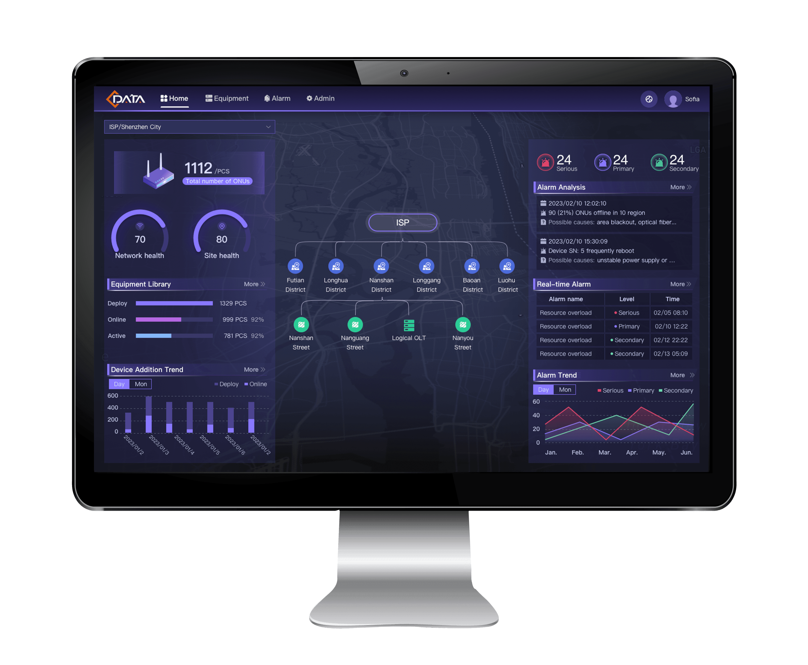
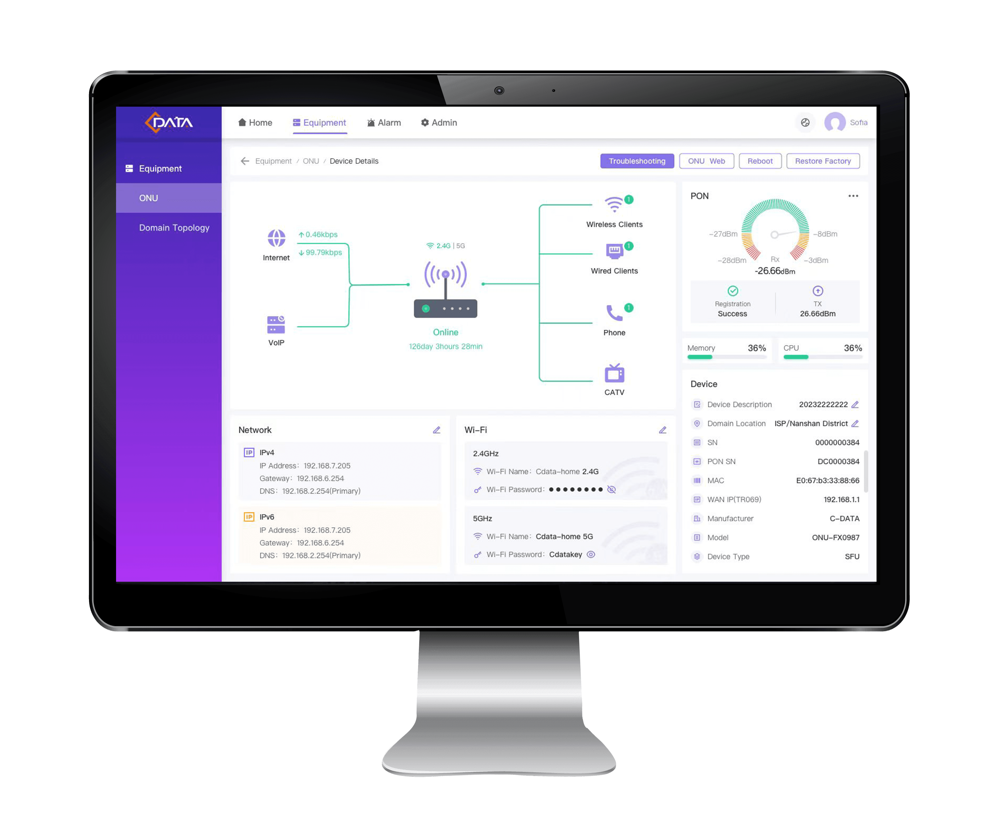
Intuitive Operate Interface, Easy to Use
Intuitive and user-friendly features design. Easier to operate than most of the third party ACS trools.
No need more professional TR069 protocol knowledge for operators.

Slide 3
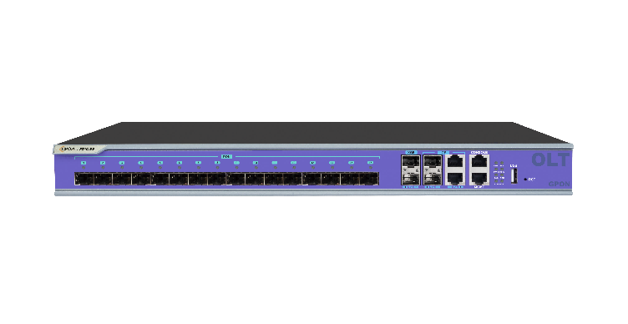
Integrated EMS and TR069 ACS
Normally operators manage OLT devices through “EMS” software, and manage HGU etc. terminal devices via ACS software through TR069 protocol. Now, CMS put them together. It’s more convenient for operators to handle the whole network.
MQTT
OMCI/OAM for Basic management
C-Data CMS
C-Data OLT supports CMS
EMS Features
ACS management for service
Configuration and service management by TR-069
C-Data CMS
X
OLT which don’t support CMS
EMS Features
ACS management for service
Management ONU terminals directly through TR069
One-stop management：One platform one interface to manage both OLTs and ONUs.
Excellent compatibility：Manage ONU terminals directly through ACS features, bypass the third party OLT, no more worry about the compatibility issues on service management.

Slide 4
More Over-Value Features Design
CMS platform is not only an integrater of EMS and ACS trools, but also give more and more over-value features,
which will help the operate engineers to fast their work and make more efficient value.
Devide the work by Domain
Smart Alarm Analysis
Optical Level Guide
Device Statistics by Status
Network Status Analysis
Realtime Device Work Status
Smart statistics and analysis：Based on the smart statistics and analysis, CMS will help the manager to know more about their network situation.
Efficient management：CMS will help the ISPs to build a manageable and controllable effciency network. And also help you to improve the service ability.

Slide 5
Main Features
····
Third-party device
+
Supports local and cloud deployment(coming soon)
Maximum management of 100,000 devices
Unified management of all manageable devices of C-Data
future versions can supports third-party device management with open interface

Slide 6
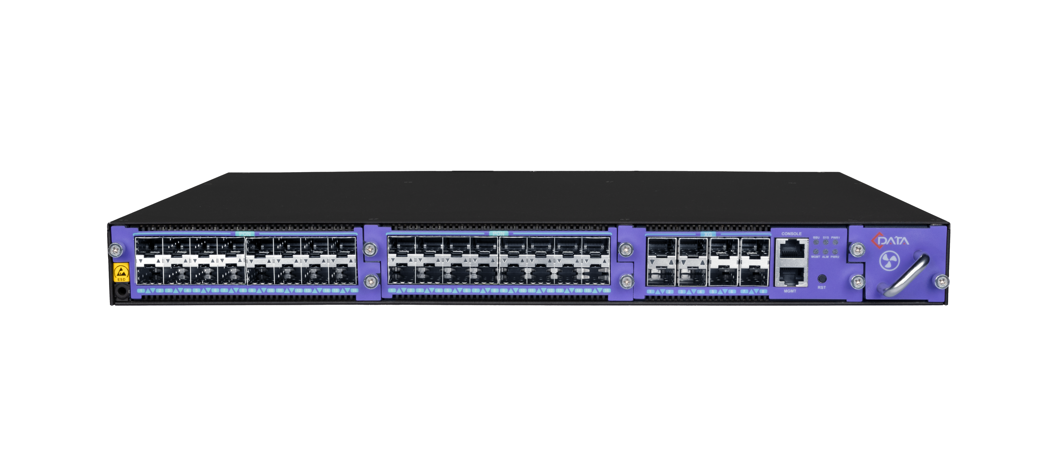
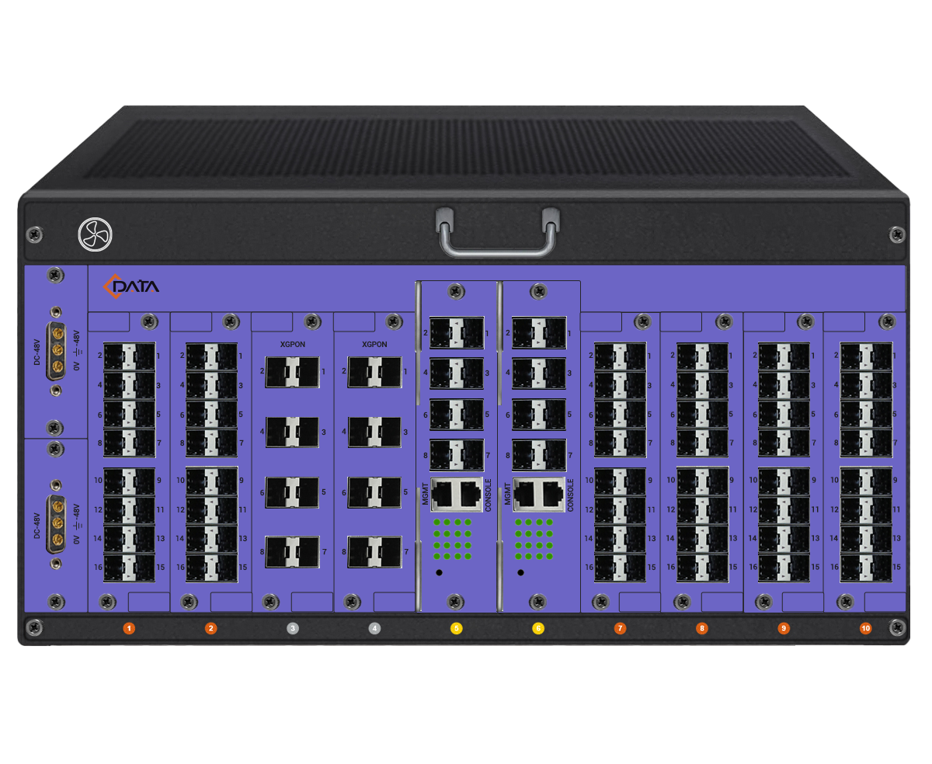
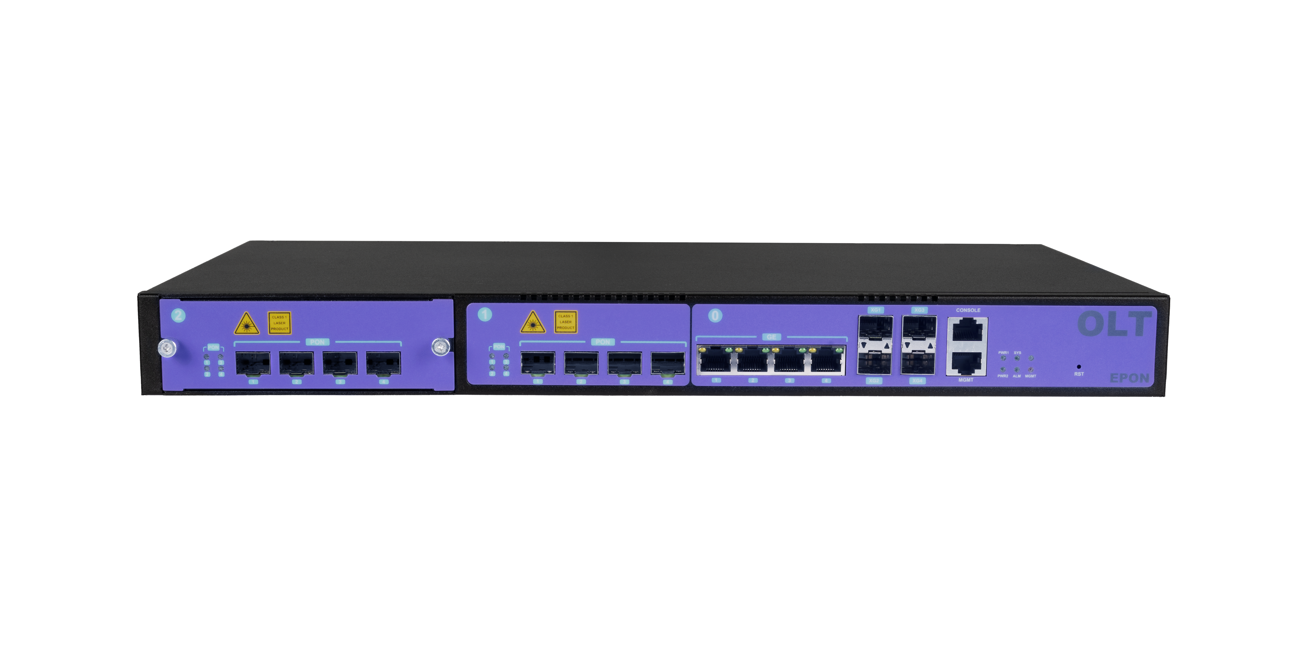
GPON/EPON OLT B1 supporting CMS
GPON OLT B1/B2
Flexible GPON OLT_March 24
Compact but powerful
1RU rack-mounted
Support full service management
Optional 4*10GE
uplink ports
GPON/XG(S)PON/10G EPON hybrid
High density
AC/DC dual power supply (1+1 backup)
Universal PON slots
Highly customized
Smooth evolution
4/8/16-Port
4- to 32-Port
EPON OLT B1
4*fixed ports + 4*optional ports
Hot-pluggable
Support QoS for improving traffic control
Agile network expansion
4+4-Port
Up to 128-Port

Slide 7
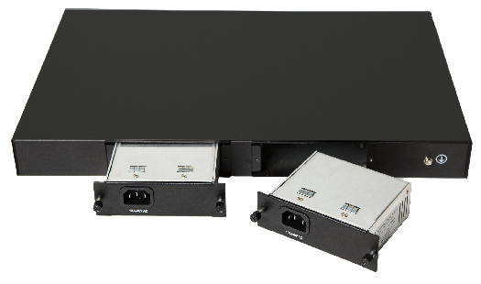
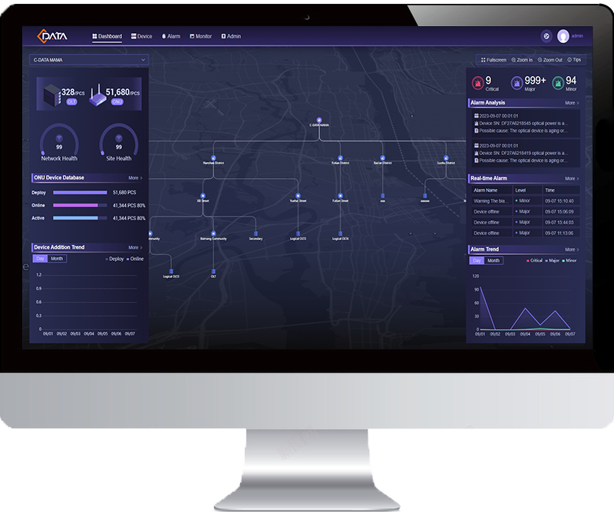
GPON OLT New Upgrade
New Upgrade
Pluggable
Power Modules
Soft-start for power supply.
Optional AC/DC/BBU and assignable priority.
FD1604/08/16S-B1
Compact
Size
Uniform dimension of modules for all 4/8/16-port.
Easily storage and transportation.
Only 265mm deep, fits into general purpose shallow cabinets, saving server room space and cost.
265mm
FD1604/08/16S-B1 not support CMS
CMS &
OLT WEB3.0
Support rapid deployment, real-time monitoring and flexible management.
User-friendly and visualized pages
Heat Dissipation Optimization
Optimized module spacing.
Professional air duct design.
Intelligent variable fan speed design.

Slide 8
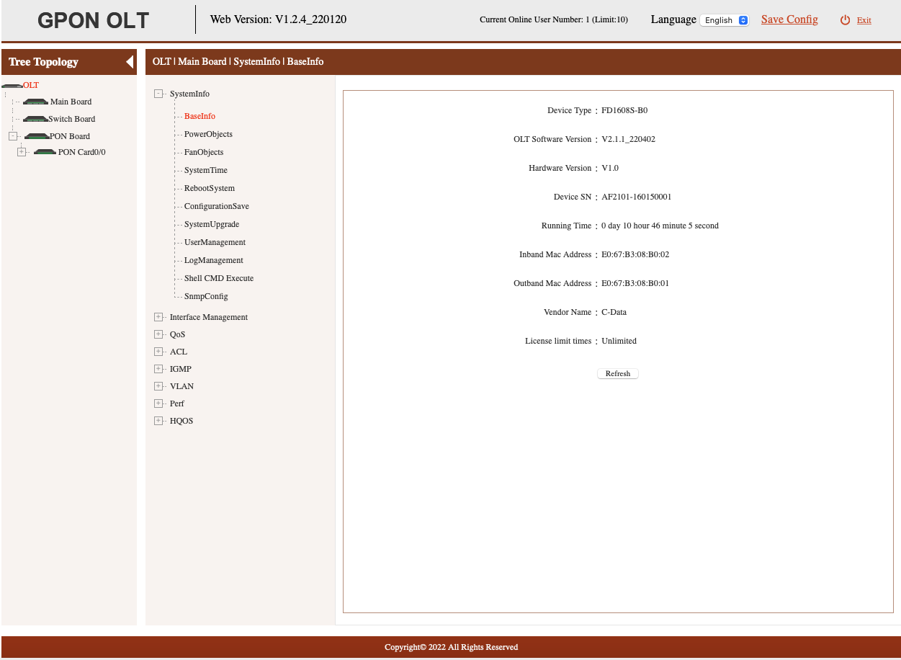
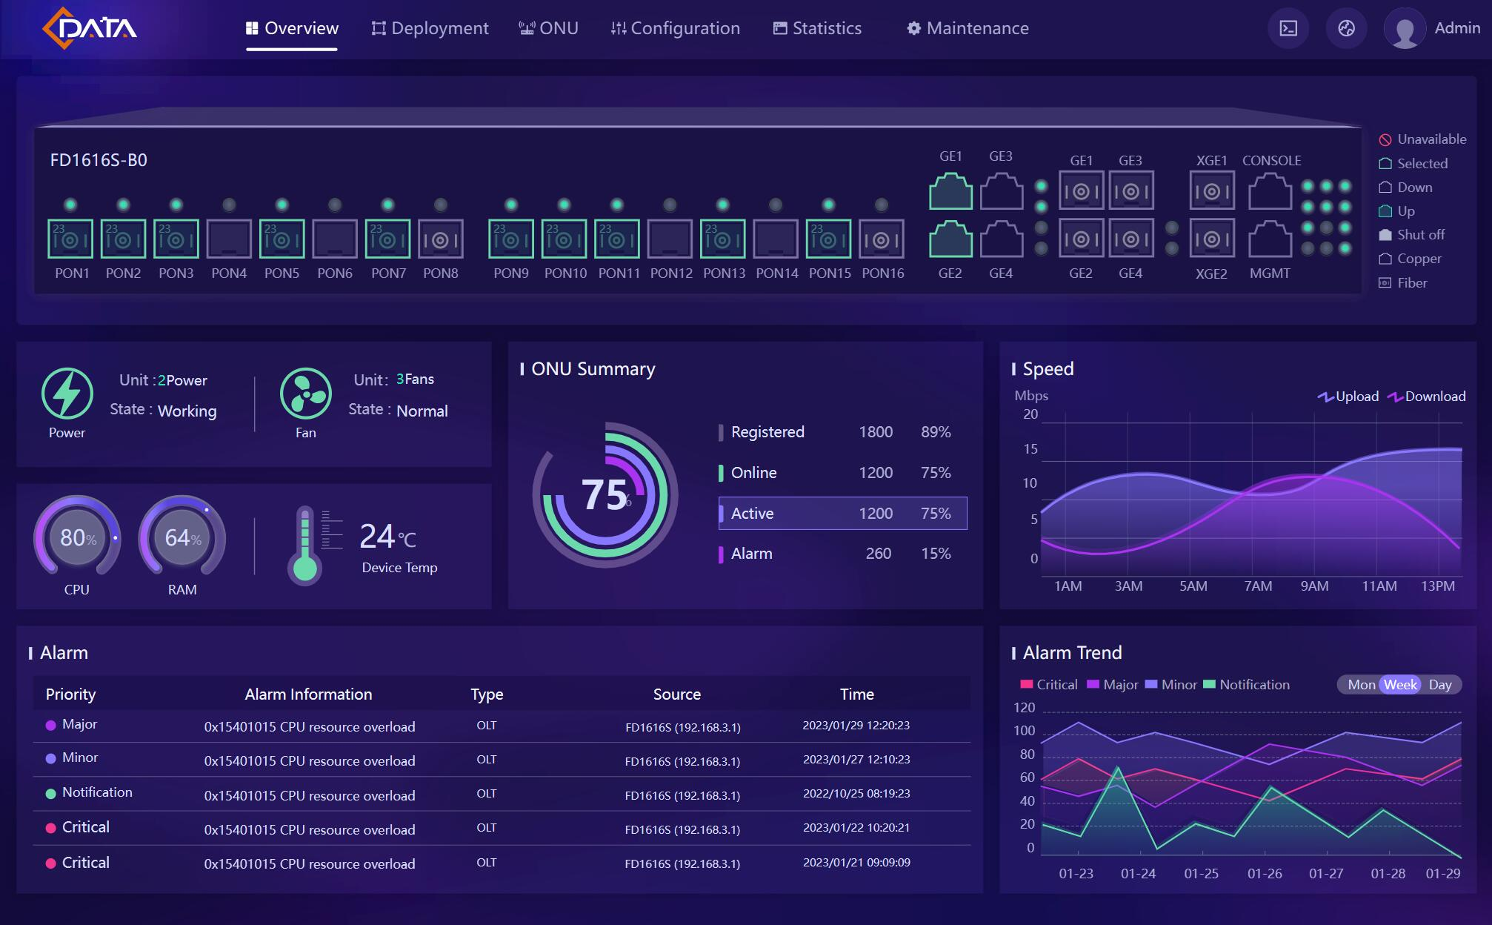
OLT WEB Management Interface upgrade— WEB 3.0
The new interface can not only improve the user experience, but also reduce the study cost.
Traditional OLT WEB
C-Data New OLT WEB 3.0

Slide 9
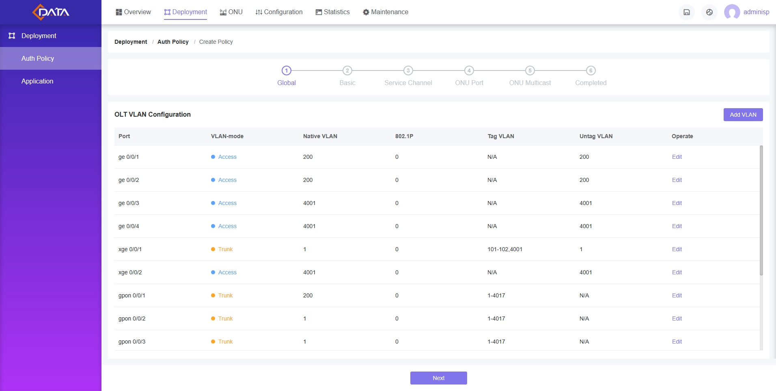
Rapid Deployment With OLT WEB Guidance
1
Global
Global VLAN configuration
2
Basic
ONU capability planning
3
Service Channel
GEM/TCONT/DBA....
4
ONU Port
ONU port configuration
5
ONU Multicast
Multicast configuration
6
Completed
Create policy completely

Slide 10
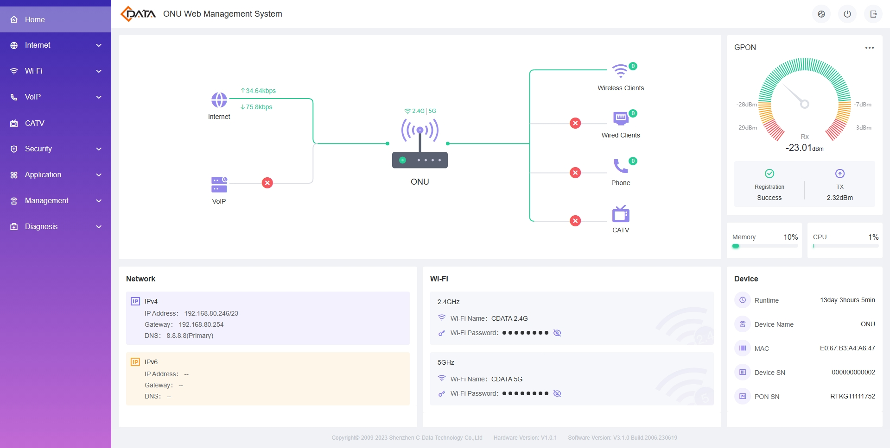
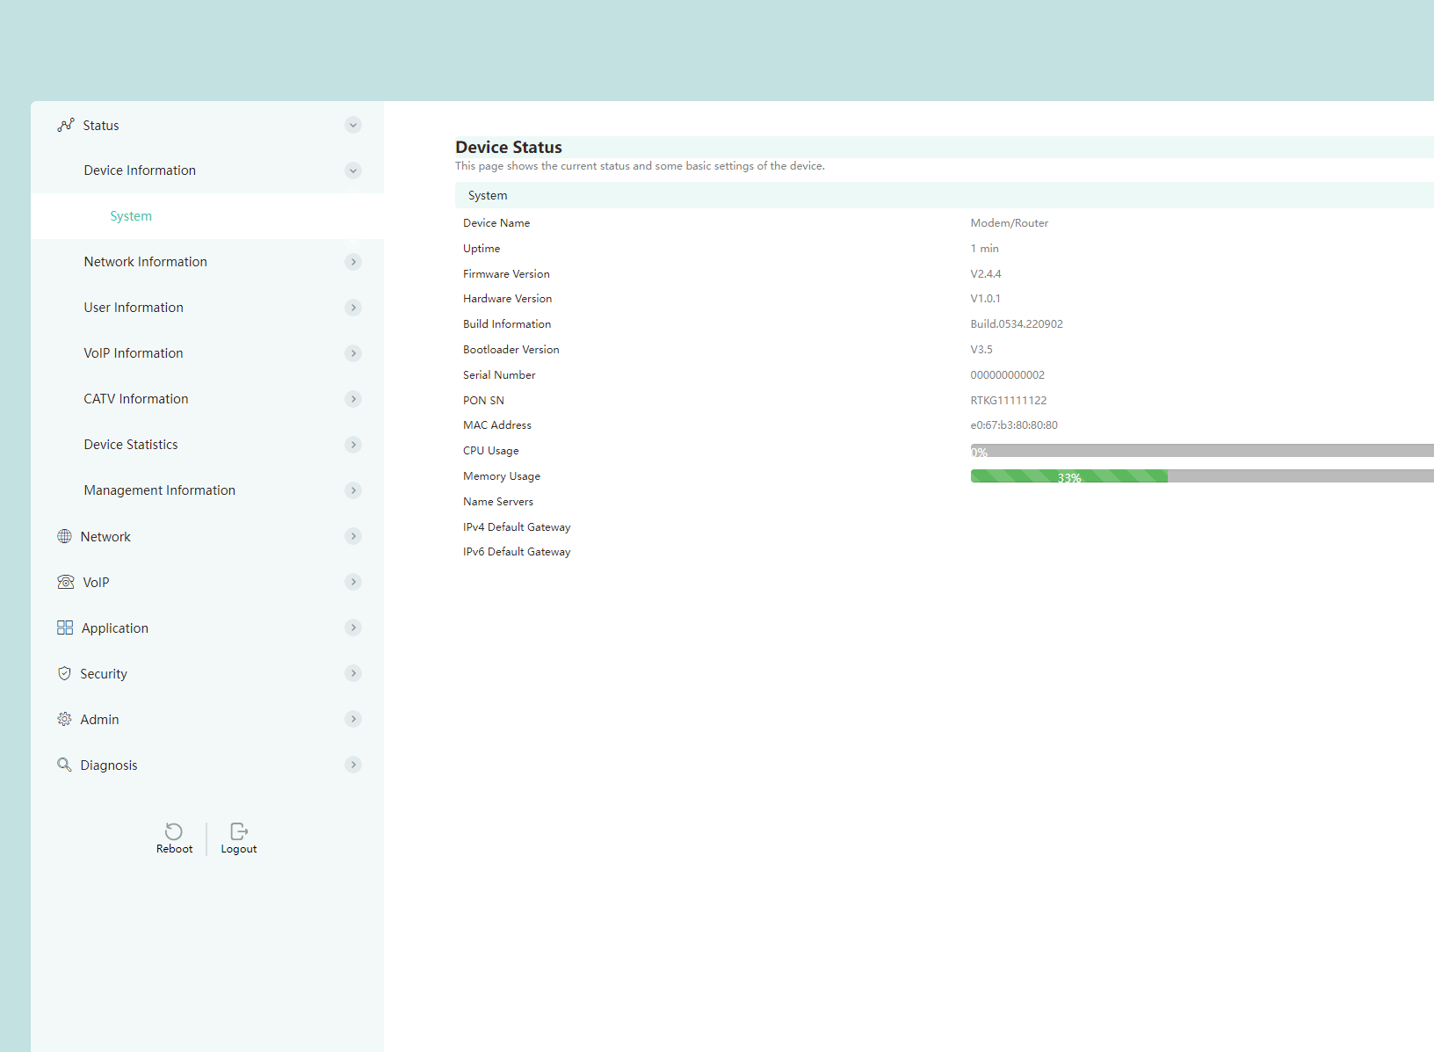
New ONU WEB 3.0
Currently, only 07C chipset support WEB3.0, the main models are 4GE, 4GE+AC WIFI, 4GE+WIFI6 (POTS/CATV)
1GE ONU web 3.0 software
will be released in March 2024
Traditional ONU WEB 2.0
New Designed ONU WEB 3.0

