Slide 1

CMS APP Introduction
Cloud Management System
Shenzhen C-Data Technology Co., Ltd.
Oct. 2024

Slide 2


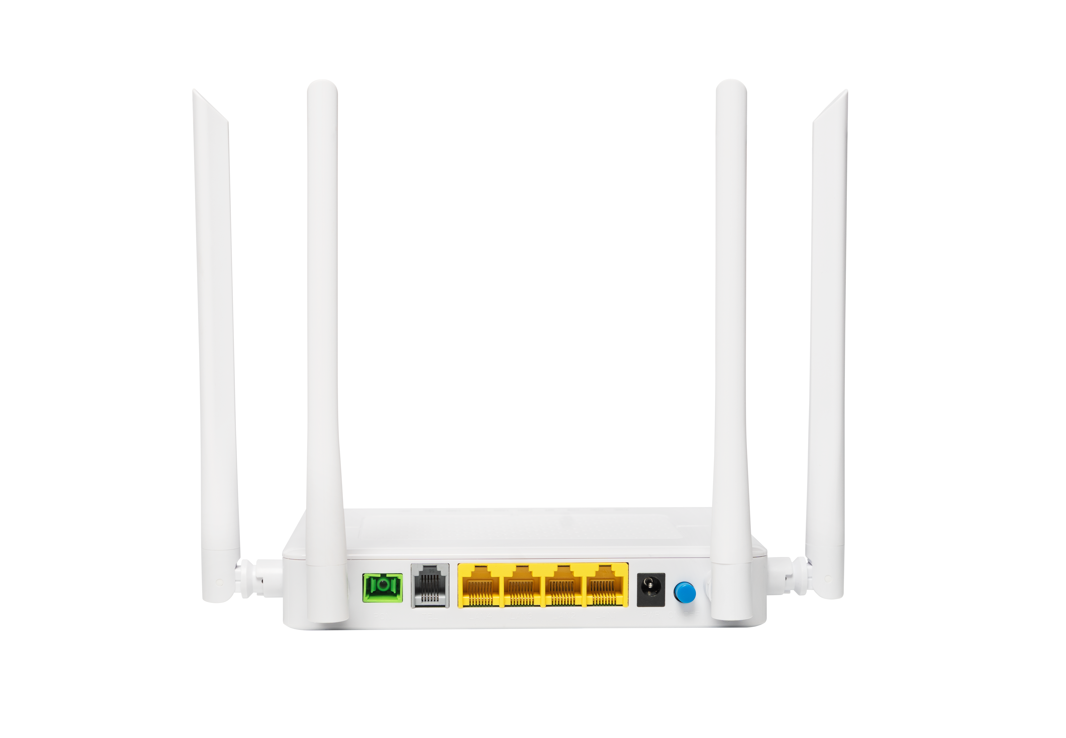
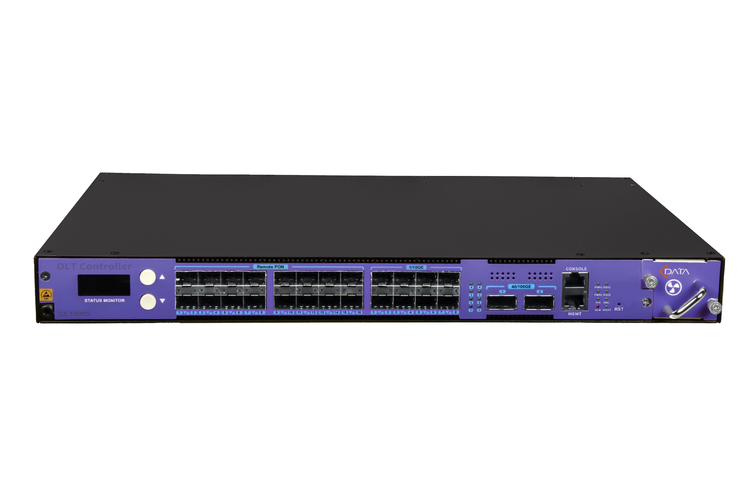
Industry Challenges - for Reseller
Price
High
Selling Only Hardware Products
Homogeneous Competition and Price Wars
Difficult to Make a Profit
1
2
3
Low

Slide 3
Industry Challenges - for ISP
Too expensive
Too complicated
OLT can barely manage
Unnecessary
No Need
No Suitable
Suffering
Inefficient in handling user problems
Weak Network Service Capability
Poor OLT Management Compatibility
1
High investment costs
High labor costs
High maintenance cost
2
3

Slide 4









Why Choose CMS APP？
Free software is included with hardware purchases
Compatible with both iOS and Android platforms
Supports both on-premise and SaaS deployments
The CMS APP employs data encryption, access control, and comprehensive information security protocols. Automatic backups on Amazon Cloud ensure your data is securely stored and exchanged via SSL certificates.
Amazon Cloud
SSL certificates
Robust security measures ensure data protection
Data Encryption
Access Control

Slide 5




Why Choose CMS APP？
Comprehensive Business Insights
Easy Installation and Setup
Intelligent Maintenance
User-Friendly and Cost-Effective

Slide 6


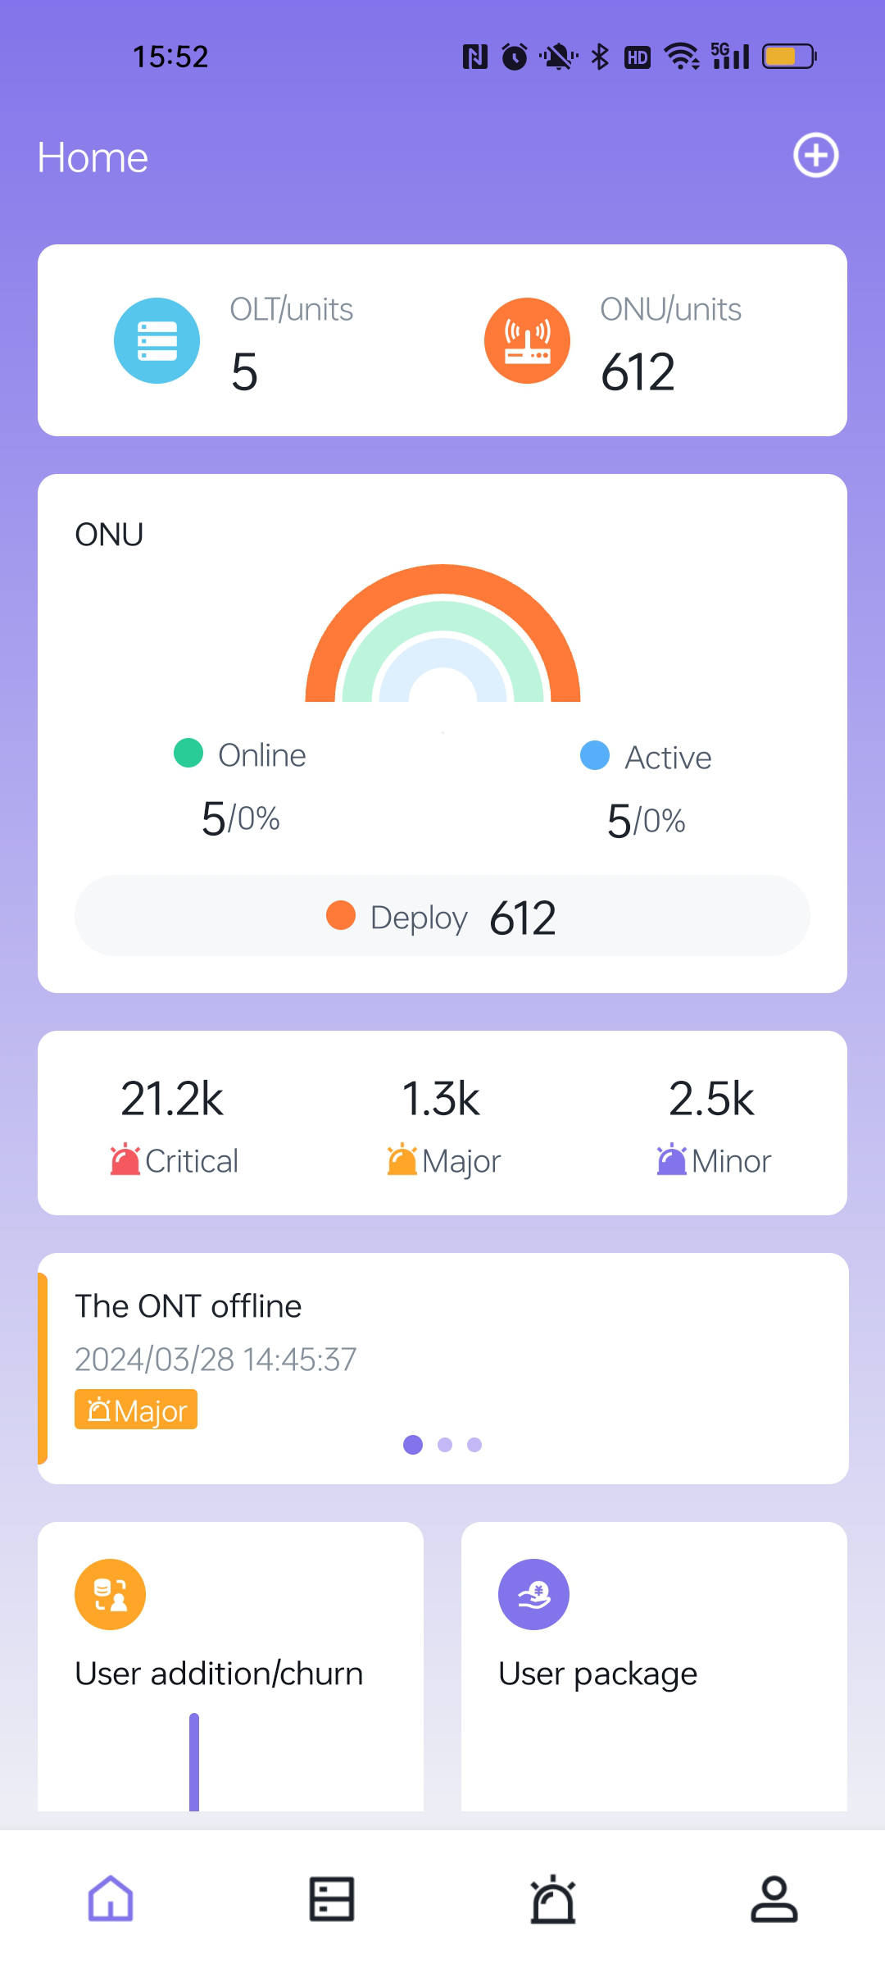
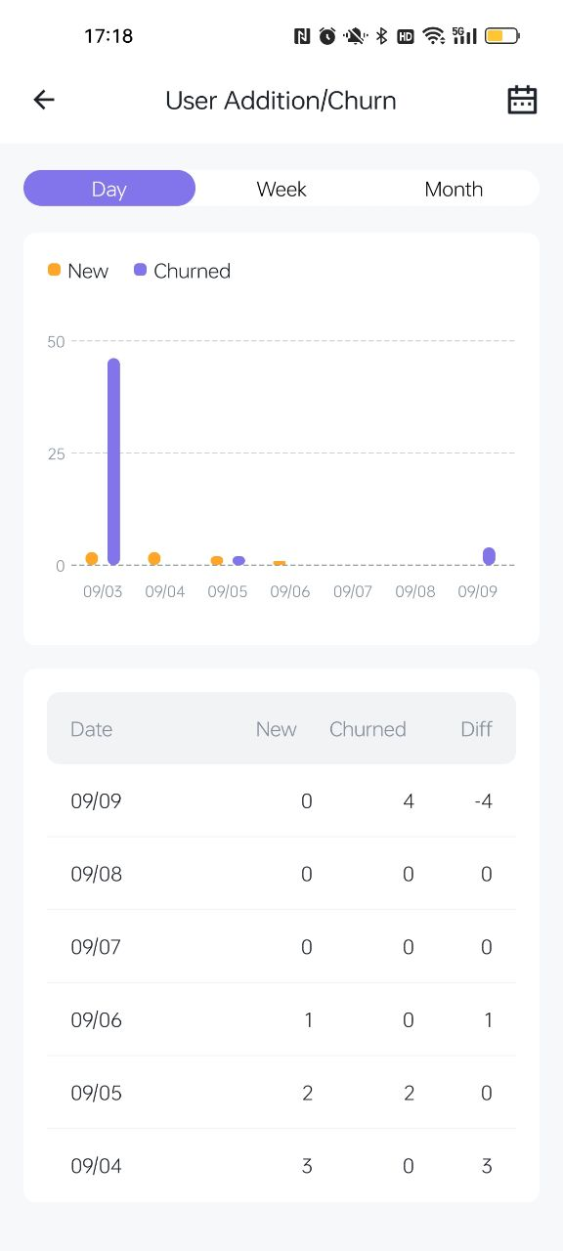
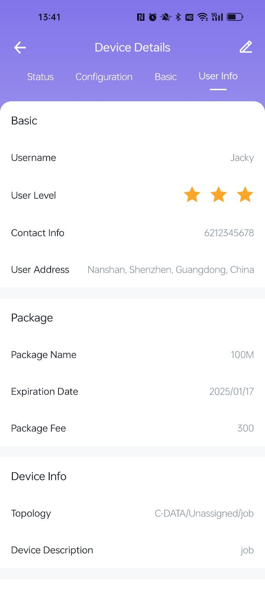

Comprehensive Business Insights
Unlock valuable operational insights to drive decision-making.
How many users I have
User service reminder
User addition trend
User churn trend
Package expired trend
Near expired trend

Slide 7
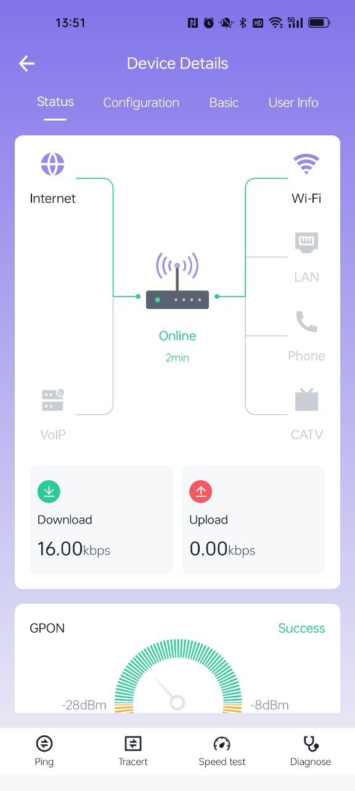
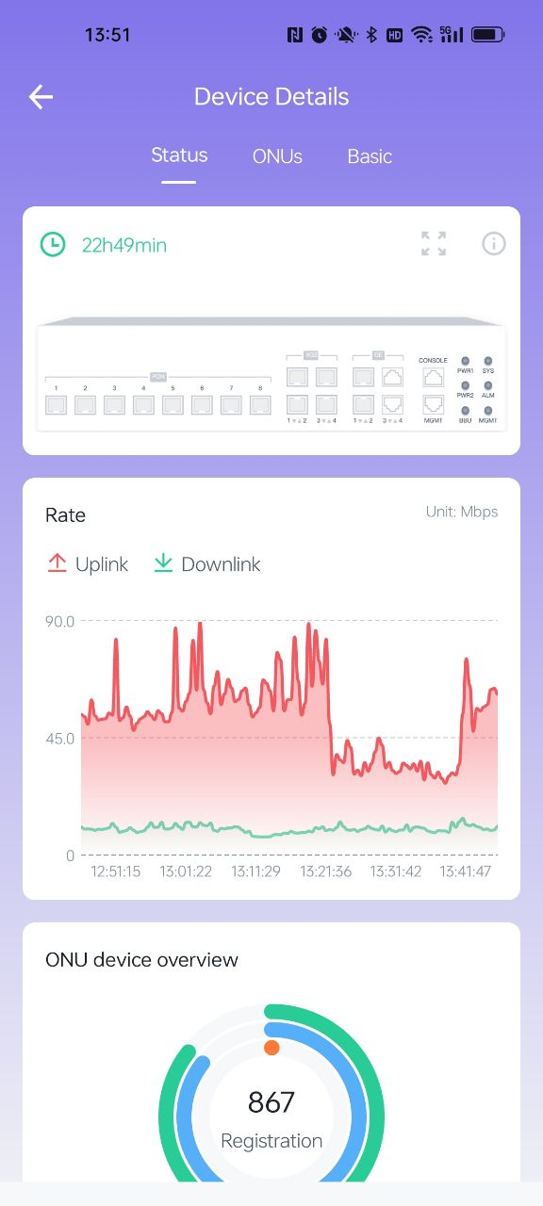
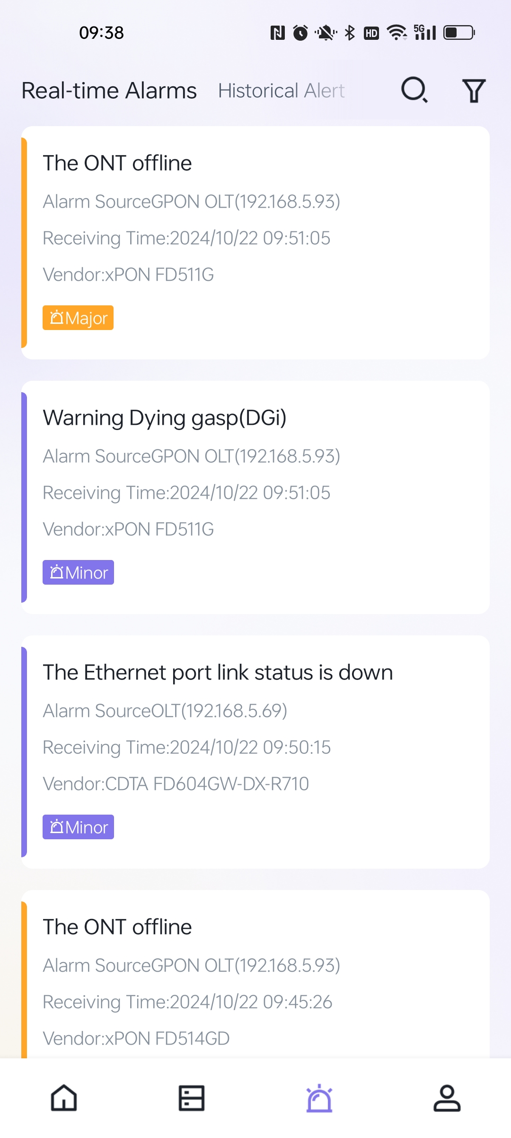
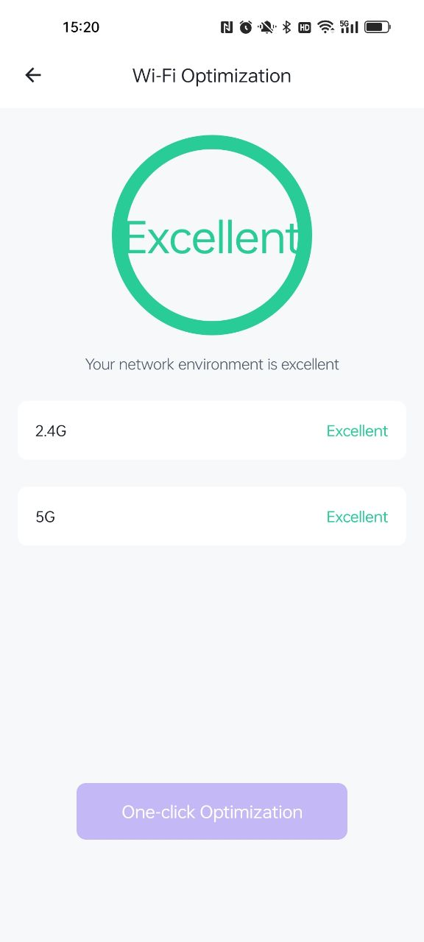
Intelligent Maintenance
Streamline maintenance and enhance user satisfaction.
ONU status
OLT status
Business warning
Wi-Fi optimization

Slide 8
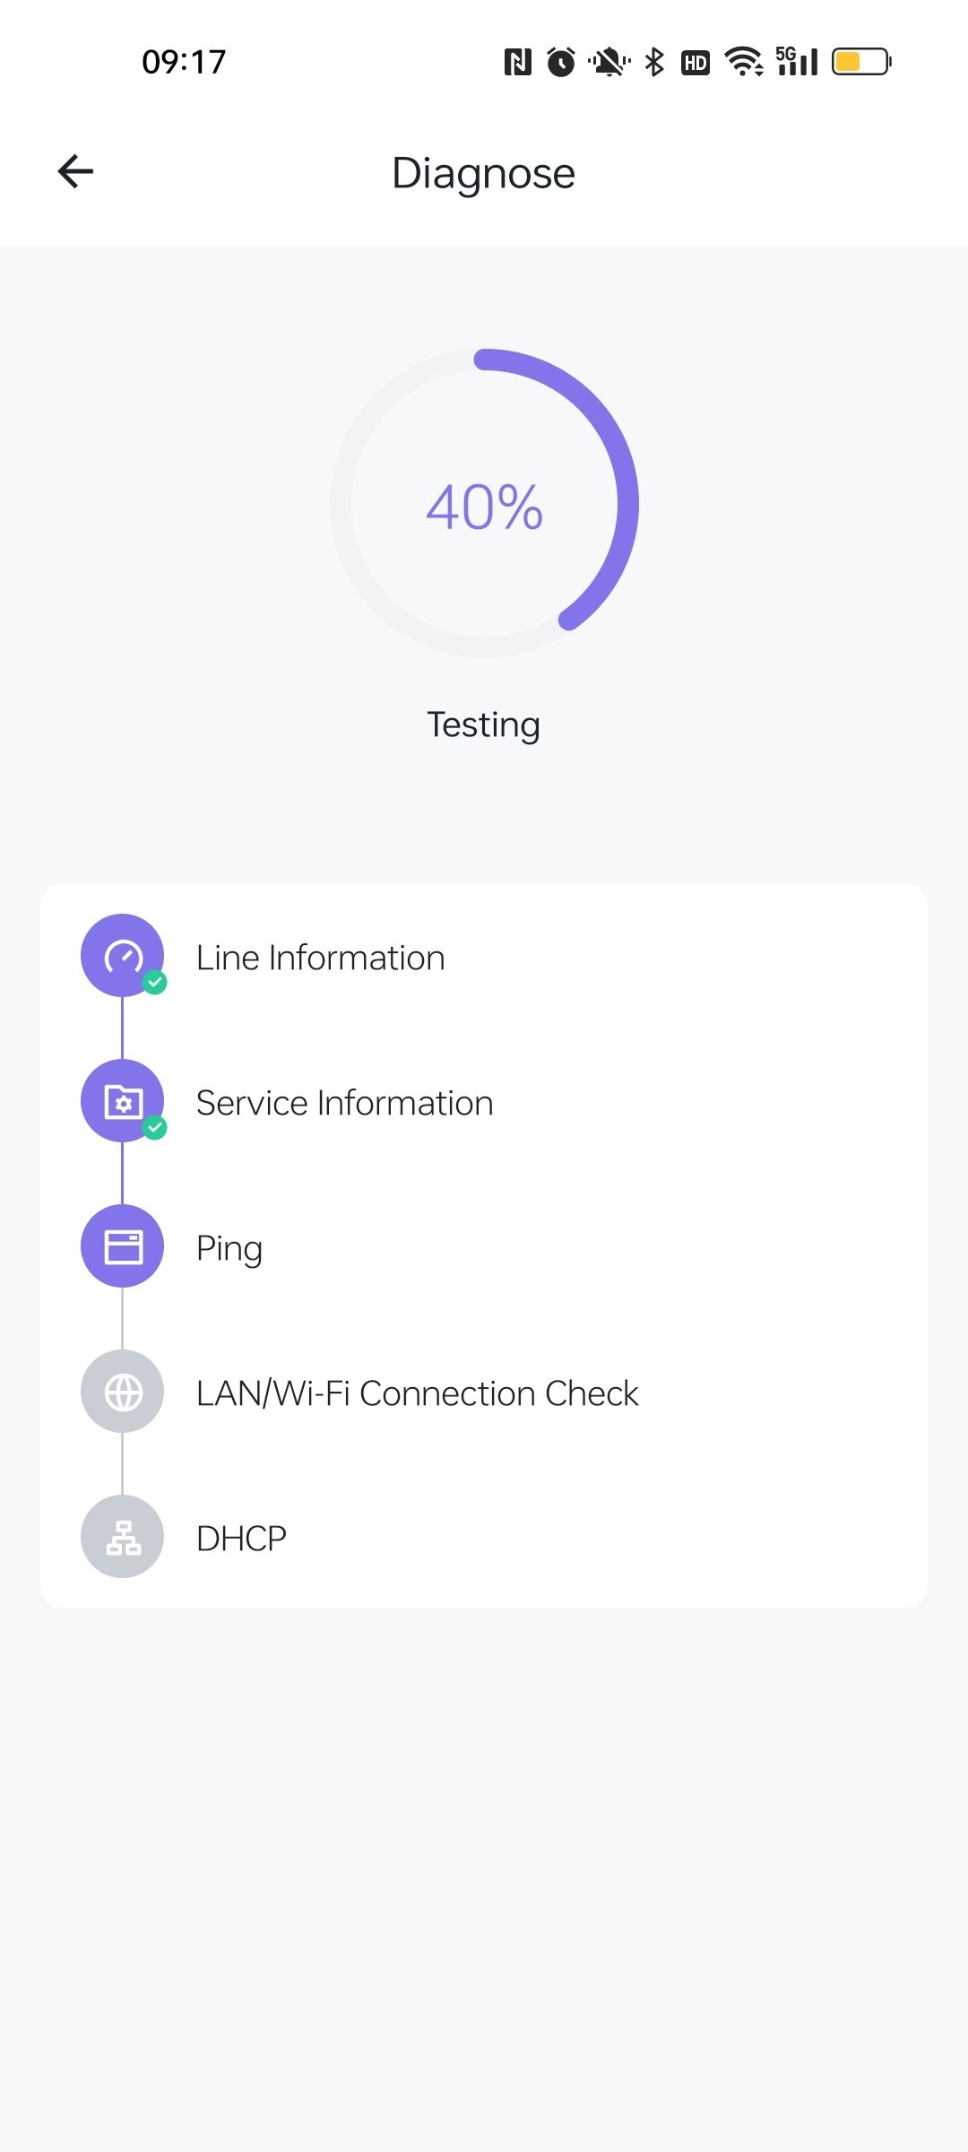

User-Friendly and Cost-Effective
One-click diagnostics, reduces the need for on-site visits, improving user satisfaction

Slide 9
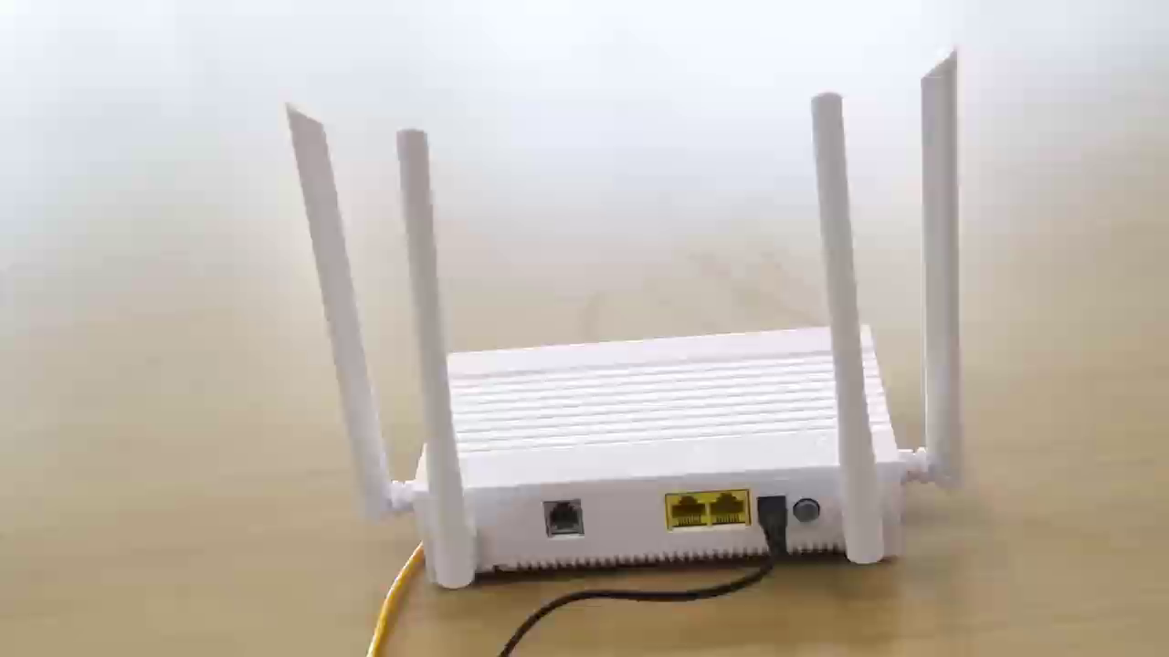
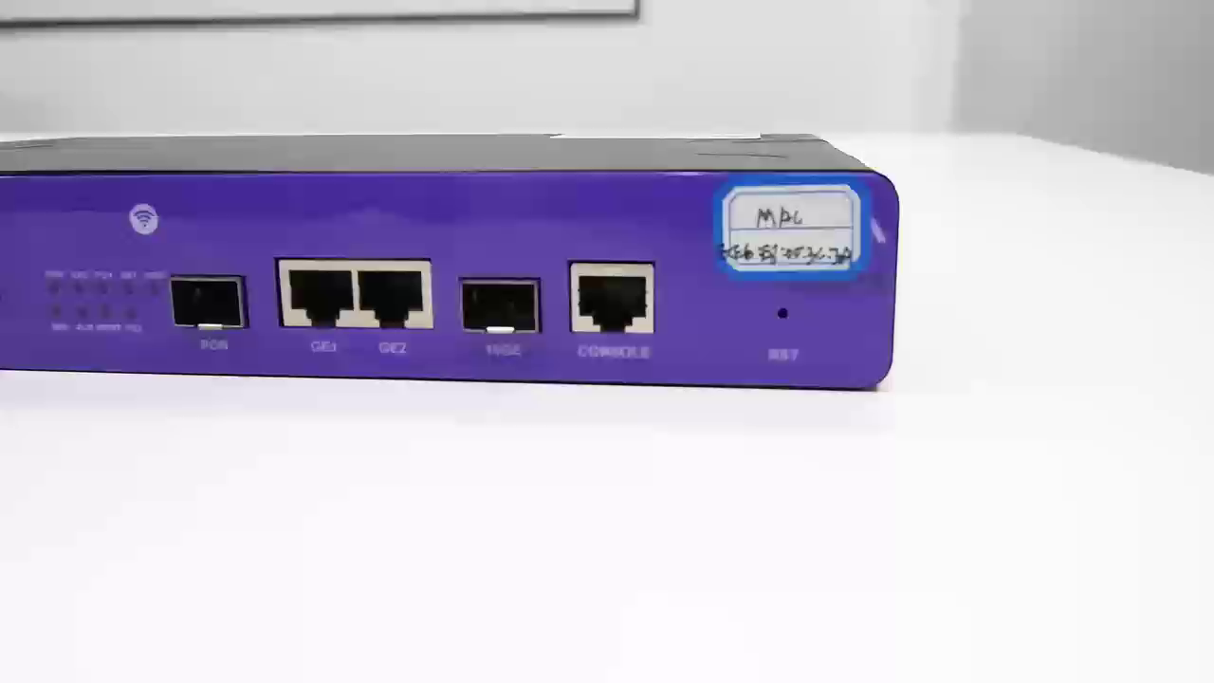
Easy Installation and Setup
Easily binding OLTs and ONUs to the CMS APP for efficient management.
ONU Demonstration
OLT Demonstration

Slide 10
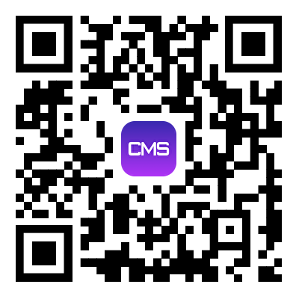
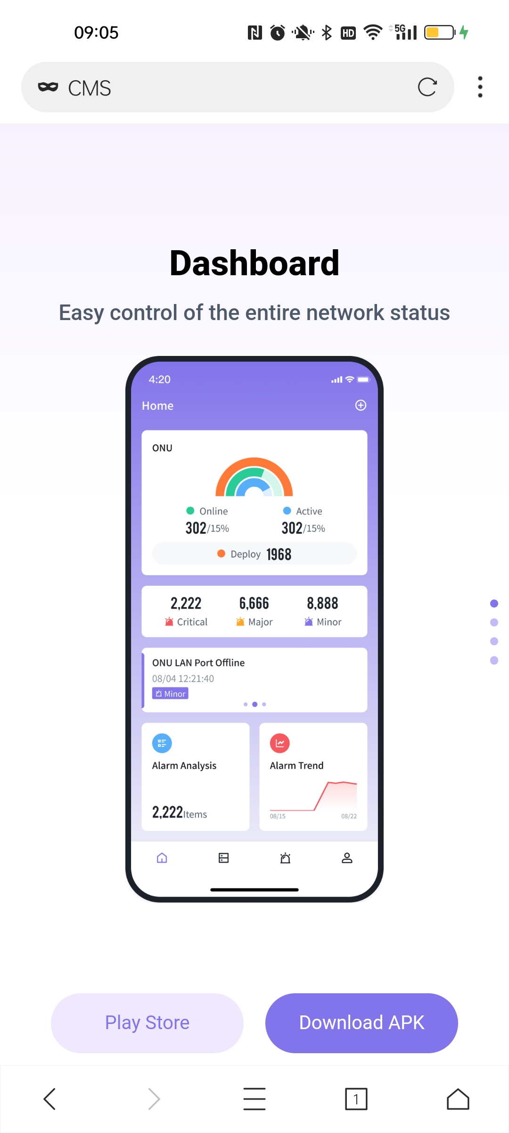
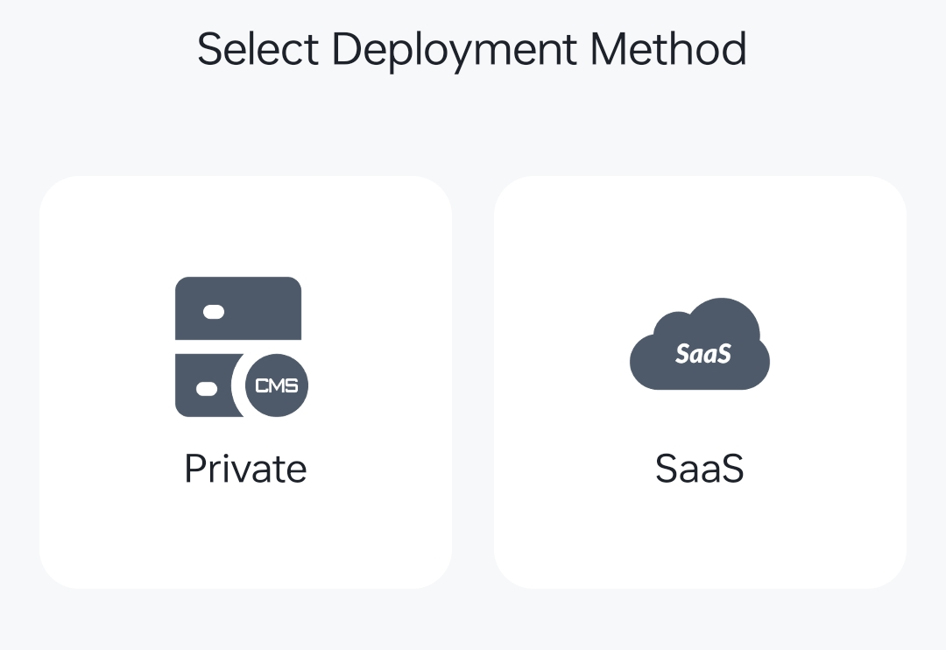
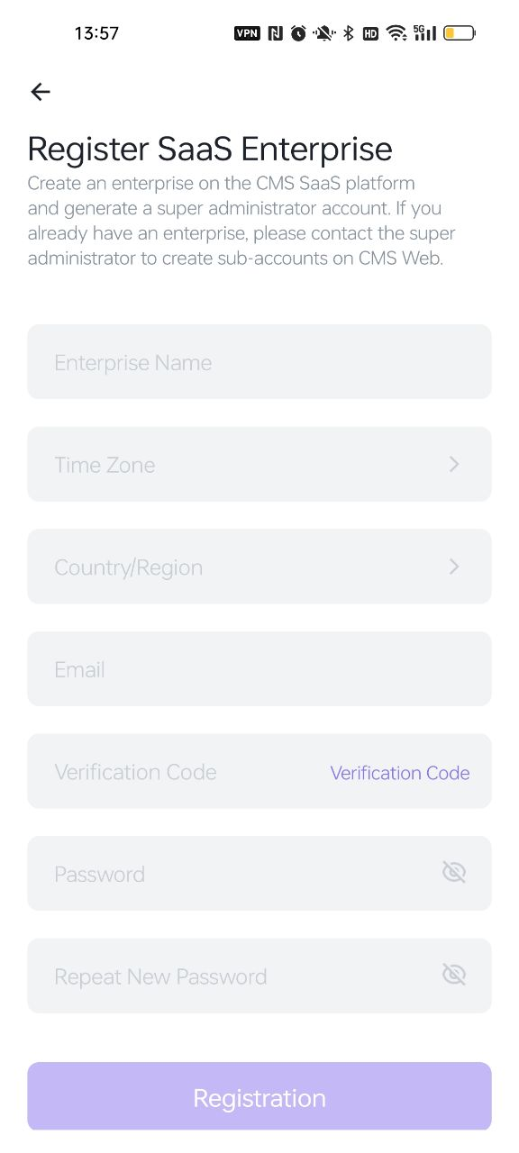
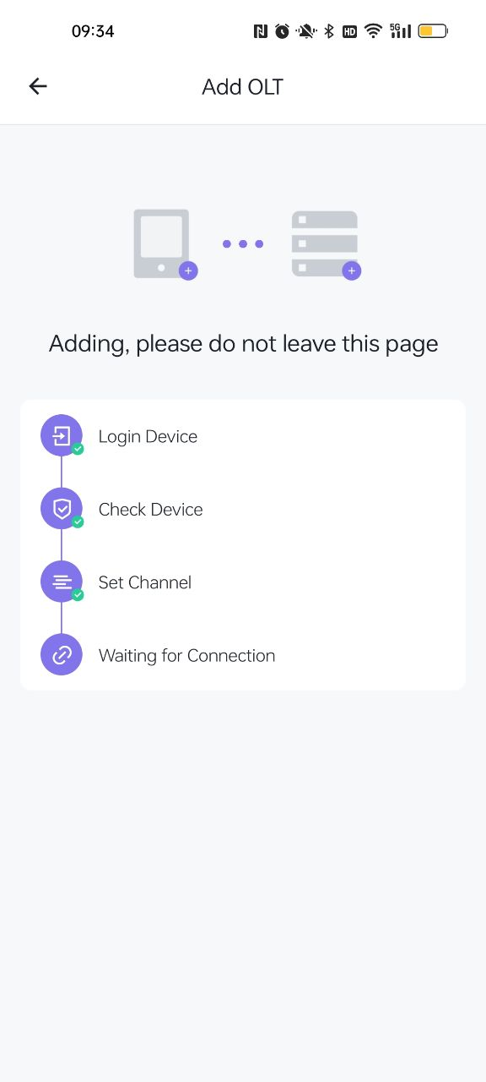
CMS APP Features: How to start CMS APP management journey in 3 minutes?
Download and Install
Register and Login
Quickly bind device
Device management

Slide 11


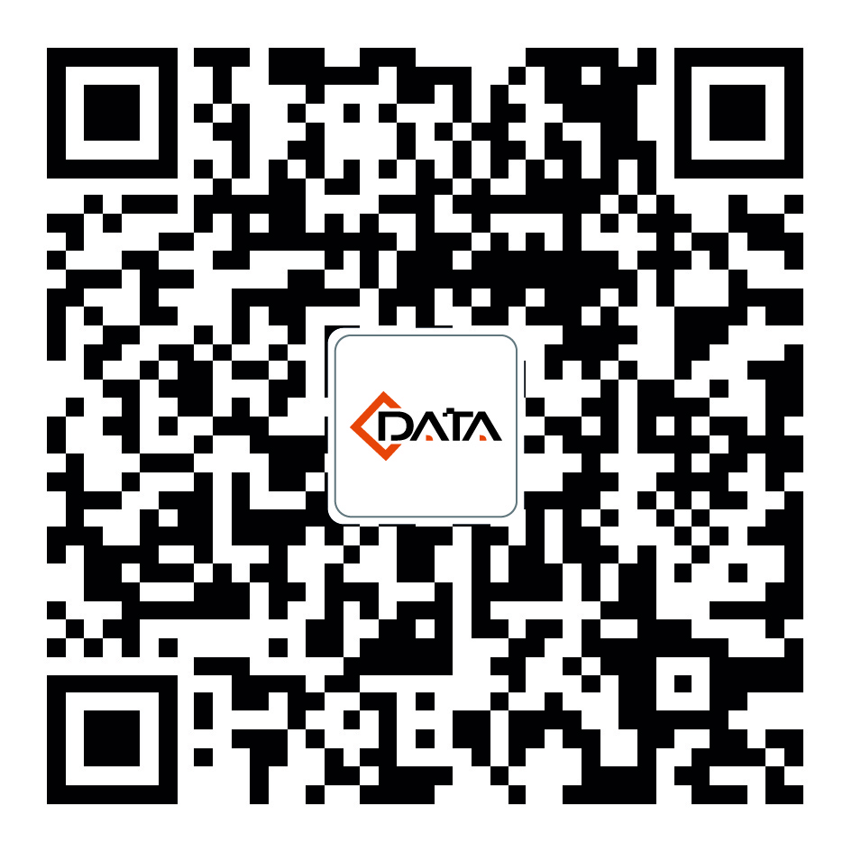
Connecting the World with Data Technology
www.cdatatec.com
marketing@cdatatec.com

