Slide 1
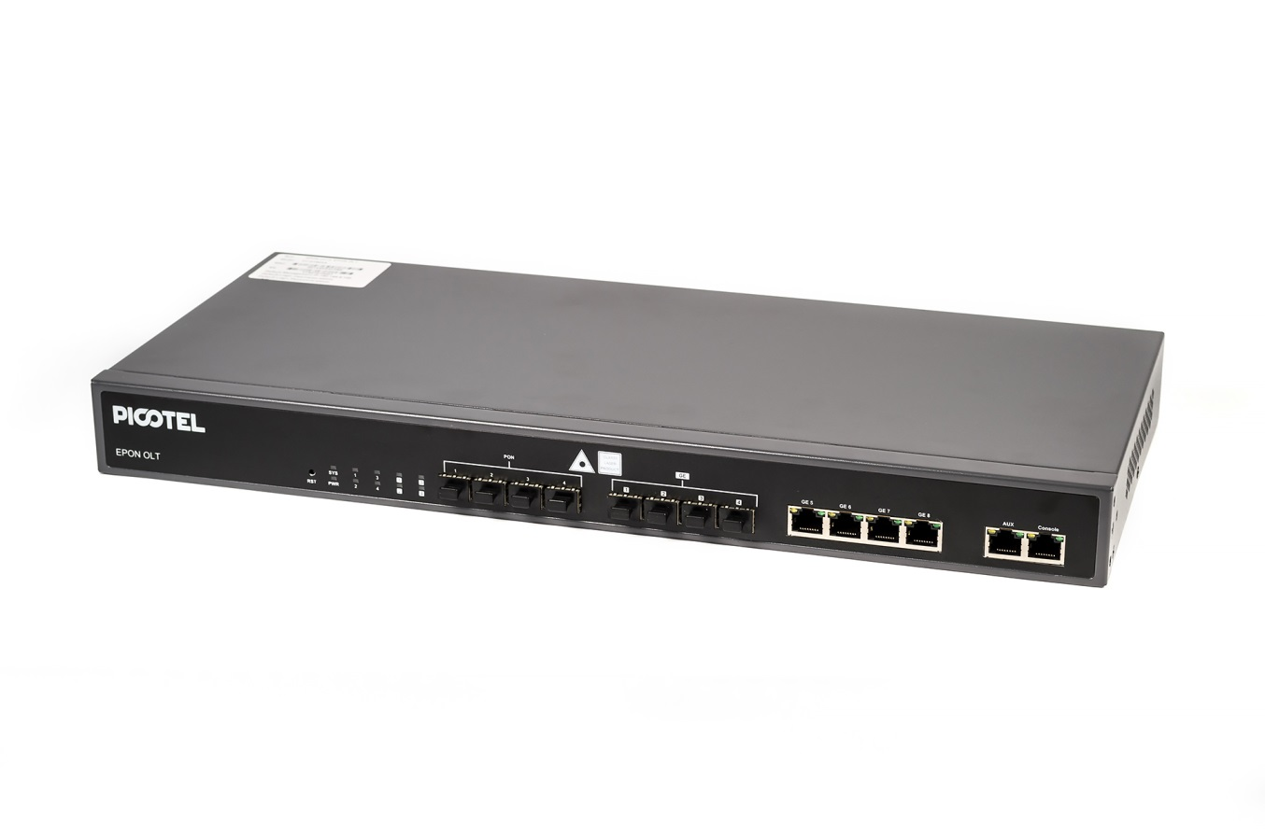
PT-E2500 Series OLT
25 шт.
New features in
2.03.26 software

Slide 2
2
From the software V2.03.26：
if the second least bit of source MAC is number 1,the
OLT will consider the source mac is invalid , it will drop
the packet. we have revised the EPON chip process , the OLT
will not drop these packets because some of them are valid
MAC address.

Slide 3
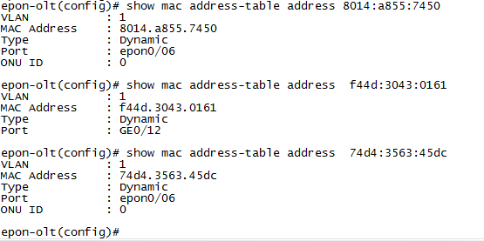
3
From the firmware V2.03.26：
the OLT can find the location of a host basing on the
host MAC address

Slide 4
4
From the firmware V2.03.26：
The new version supports automatic batch configuration ONU through the establishment of automatic configuration template, the OLT will automatically configure the template to the ONU to achieve the purpose of automatic batch configuration ONU when ONU registration is completed, the CLI configuration is as follows:
In pon interface mode：
ONU [auto-bind] profile [dba|srv|voip|alarm] id <0-32767>
show ONU [auto-bind] [profile_id]

Slide 5
5
From the firmware V2.03.26 ：
The version can provide more detailed and rich state for
a ONU ,these states include the ONU location 、 mac address 、
register time 、 deregister time 、 deregister reason and running
time .

Slide 6
6
From the firmware V2.03.26 ：
the OLT supports the third party monitor tool software such as
MRTG by adding the public SNMP, the ONU data is updated every
five minutes

Slide 7
7
From the firmware V2.03.26 ：
the new firmware supports the third party log software such as
syslog by adding a public SNMP alarm ,these include linkup and
Link down alarms, CLI configuration is as follows:
in config mode：
1, SNMP-server enable traps SNMP linkdown linkup
2, SNMP-server host <ip> udp-port <1-65535> version 1 community public

Slide 8
8
From the firmware V2.03.26 and Hardware V1.4：
the RJ45 interfaces can only participate in the RSTP protocol, SFP ports do not respond to the RSTP protocol for the previous version , our customers also pointed out the problem, this issue is because the SFP ports cannot transmit the BPDU message, the new version solves this problem.

